Slide 1
C# Fundamentals Day - 1
Hunaid Hussain

Slide 2
Introduction
Hi. This is Hunaid Hussain, and welcome to C# Fundamentals. The goal of this course is to give you all the knowledge that you need to start being productive with the C# programming language. C# has consistently been one of the top three programming languages to learn because it's used widely in the industry and it's an expressive and powerful language. In this course, we're going to learn about the C# language, as well as the .NET Framework that you'll use when building software with C# as well as learn essential topics like error handling.
We'll also discuss object‑oriented programming with C#, and I'll give you a list of my best practices for the language before we leave the course. By the end of the course, you'll be ready to contribute to your own projects with C#, and you'll also be prepared to move on to some additional C# features in more detail, like generics in C# and Language Integrated Query, or LINQ, with C#.

Slide 3
Continue..
OK so this is the very first session of this course in this session I'm going to start by teaching you the very basics of C-sharp.
One of the questions that a lot of beginners ask is What is the difference between C-Sharp and dot net.
So that's the first thing I'm going to answer here.
Next I'm going to talk about CLR or Common Language Runtime which is the runtime environment or the applications.
Next I'm going to talk about the architecture of Dot Net Applications and as part of this. I'm going to introduce you to concepts such as classes name spaces and assemblies.
And finally I will show you all these concepts in action.
I'm going to introduce you to the very basics of Visual Studio and write a very simple C Sharp application, so you can see classes name spaces and methods in action.

Slide 4
Topics
C# Vs .Net
CLR (Common Language Run-time)
Architecture of .Net Applications
Our First C# Application
Primitive Types
Variable and Constants
Identifiers
Naming Conventions
Integral Numbers
Real Numbers
Character
Boolean
Scope
Hands-On Demo

Slide 5
Continue..
Type Conversions
Demo: Type Conversions
Operators
What are logical operators?
Demo: Operators
Comments
Quiz 1: Fundamental of C# and .NET
Quiz 2: Primitive Type and Expressions

Slide 6
C# Vs .Net Framework
OK what is dot net framework and how is it different from C-Sharp
some developers who are absolutely new to C-Sharp don't know the difference.
So in this session I'm going to talk a little bit about C-Sharp and dotnet framework .
C# is a programming language.
Dot Net is a framework for building applications under Windows. Dotnet framework is not limited to C-sharp.
There are different languages that can target dotnet framework and build applications using that framework.
Examples are F sharp or VB dot net.
Ok now what exactly is Dot Net Framework?
Dot Net framework consists of two components. One is called CLR or Common Language Runtime and the other is a class library for building applications.

Slide 7
CLR (Common Language Run-time)
OK before we understand what CLR is and why we need it. Let me explain a little bit about the history of C-Sharp.
Before C-sharp, we had two languages in the C family the C language and C++ with either of these languages. When we compiled our application, the compiler translated our code into the native code for the machine on which it was running. Which means if I wrote an application in C++ on a Windows machine with 8086 processor architecture the compiler would translate my code into the native code for that machine, that is, a Windows machine with an 8086 processor.
Now we know we have different hardware. And we have different operating systems. So if I took an application that compiled the application on the computer with a different architecture that would not run.
So when Microsoft was designing the C-sharp language on the Dot Net framework they came up with an idea that they borrowed from the Java community. In Java when you compile your code, It's not translated directly into the machine code. It's translated into an intermediate language called bytecode and we have the exact same concept in C-sharp.
So when you compile your C-Sharp code the result is what we call IL or intermediate language code, is independent of the computer on which it's running. Now we need something that would translate that code into the native code or the machine that is running the application. And that is the job of CLR (Common Language Runtime).
So CLR is essentially an application that is sitting in the memory whose job is to translate the code into the machine code. And this process is called just in time compiler action or JIT.
So with this architecture you can write an application in C-sharp and you don't have to worry about compiling that into the native code for different machines. As long as a machine has CLR both can run your application.

Slide 8
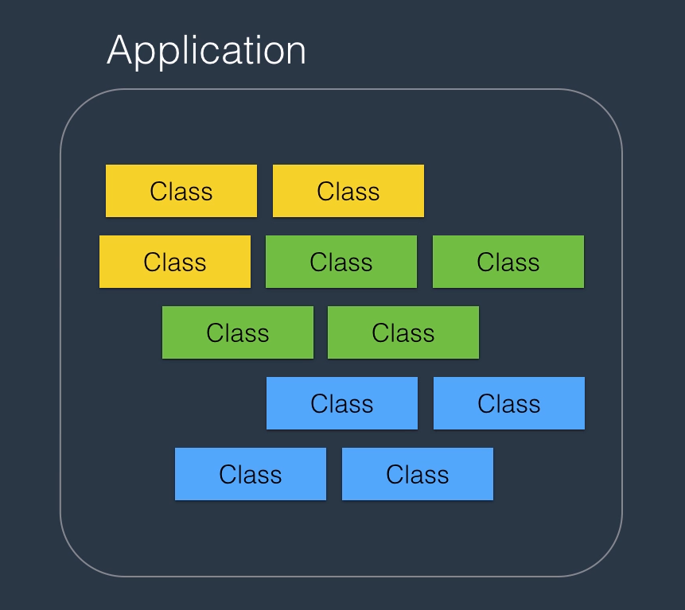
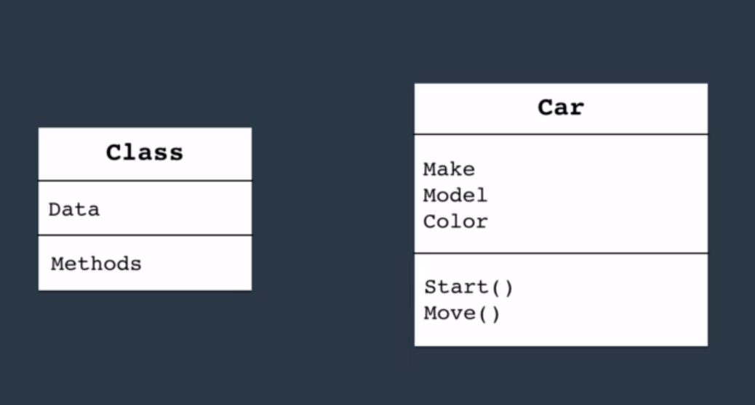
Architecture of .Net Applications

Slide 9
Continue..
OK now let's learn about the architecture of talking about applications at a very high level.
When you build an application with C-Sharp your application consists of building blocks called classes.
These classes collaborate with each other at runtime. And as a result the application provides some functionality.
Now what is a class? A class is a container that has some data which is also called attributes and functions, which is also called methods.
Functions or Methods have behavior. They execute code. They do things for us.
Data represents the state of the application.
Let me use an example.
Think of a car a car has some attributes like its make its model its color. These are the attributes of a car. The car also has some functions.
We can start it or we can move it so you can think of a car as a class in a real world application.
We have tens, hundreds, or even thousands of classes. Each class responsible for a piece of functionality.
An example of that is, classes that are responsible for getting the data from the user, process the data and display something to the user.

Slide 10
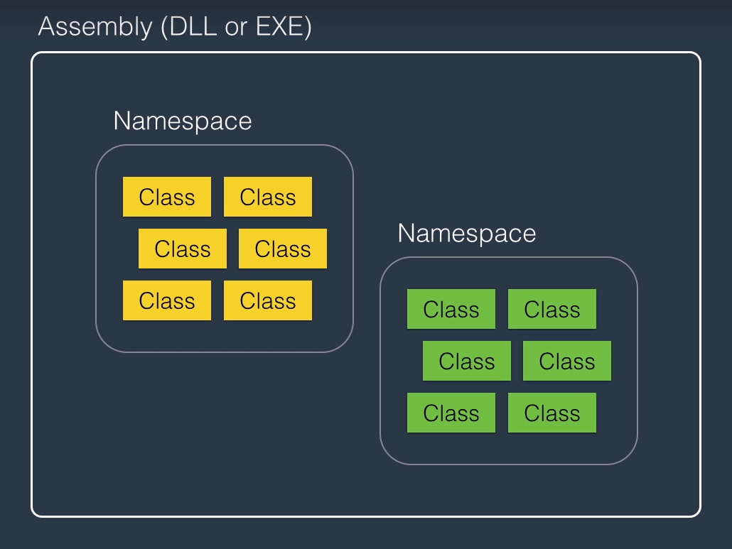
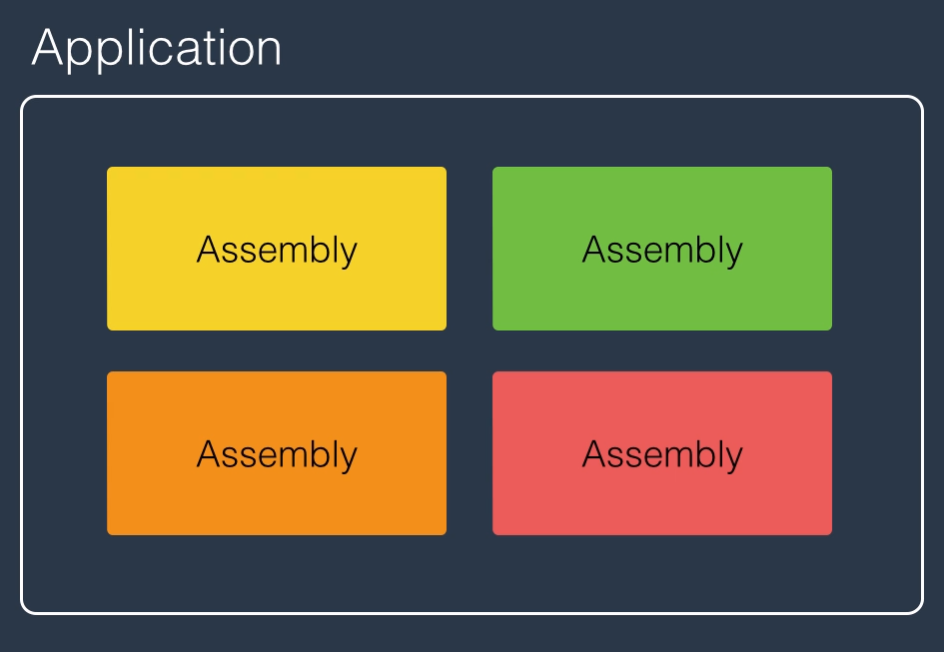

Slide 11
Continue..
Now as the number of classes in an application grows we need a way to organize these classes, that’s where we use a namespace.
So a namespace is a container for related classes.
For example in dotnet framework we have name spaces each containing tens of related classes. We have name spaces for working with data like databases. We also have name spaces for working with graphics and images. We have name spaces for working with security now in real world application as these name spaces grow.
We need a different way of partitioning an application and thats where we use an assembly, and assembly is a container for related name spaces. Physically its a file on the disk which can either be an executable or a DLL which stands for dynamically linked library.
So when you compile an application the compiler builds one or more assemblies depending on how you partition your code in the next picture.
We can write a very simple C# application and you're going to see all these concepts and action

Slide 12
Get Visual Studio IDE
To write C# code, you need Microsoft Visual Studio. Visual Studio comes in different editions: Community, Professional and Ultimate. As an individual, or a student or a small team, you can download Visual Studio Community Edition for free and build your free or paid apps with it.
To download Visual Studio Community Edition, please visit:
https://www.visualstudio.com/en-us/products/visual-studio-community-vs.aspx

Slide 13
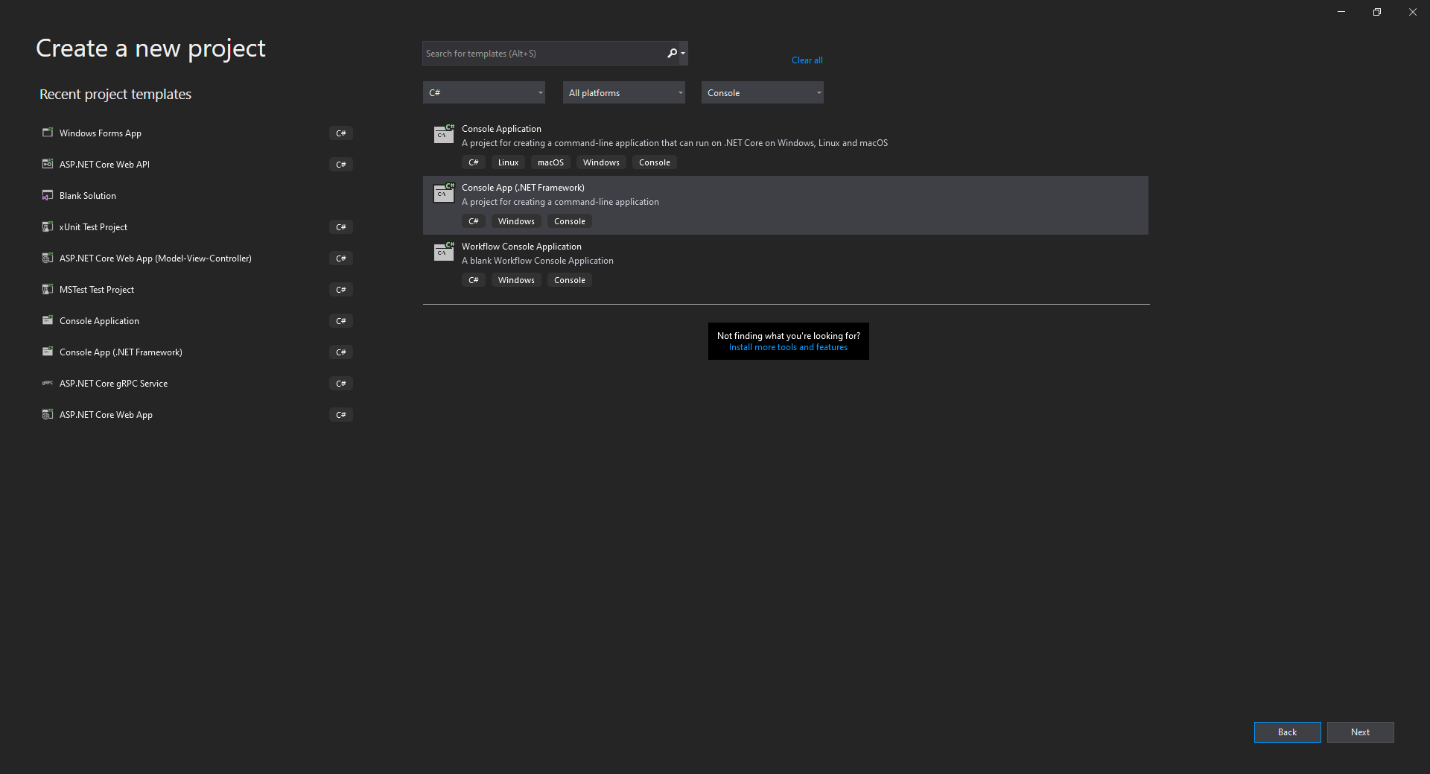
Our First C # Application

Slide 14
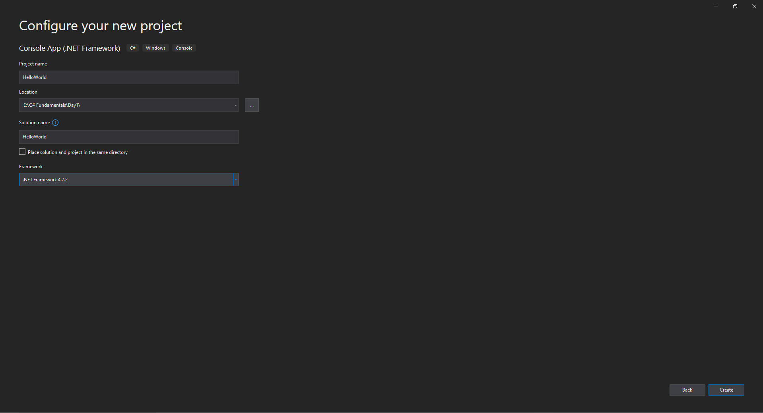

Slide 15
Our First C# Application
OK, so now we're going to have a quick tour of Visual Studio and build a very simple C-Sharp application. So here I've got a visual studio open.
Let's go to a file new project.
OK and this dialog on the left side we've got a section called templates and here you see the kind of
applications we can build with C-sharp.
So as you see in the list we can build desktop applications web applications apps for cloud, services workflows and various kind of things.
But for now, we're just going to focus on console applications. A console application is a very simple application that does not have a graphical user interface and it's a great learning tool for learning a new language. So we're not going to be distracted by various complexities of larger applications.
So, Let's select console application then give a name to the project. So let's call it hello world which is a common tradition when learning a new language and specify a location. We can put it wherever you want.

Slide 16
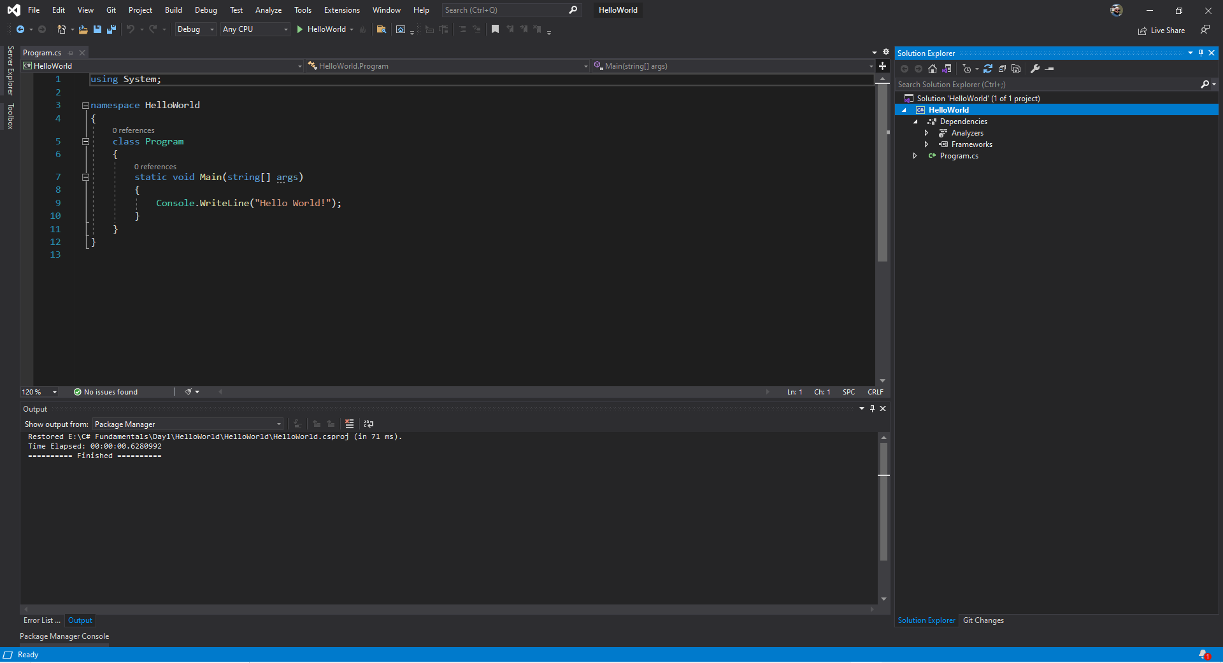

Slide 17
Continue..
You have only one solution and one project but as your application grows you can add more projects. Each responsible for something different. Now we don't have to worry about it.
All right let's see what's happening here. Some developers get a little bit intimidated the first time they open Visual Studio and that's fair enough because there are so many menus and panels here that it's a bit confusing.
But let me tell you something. Ninety percent of the time you're going to use only 10 percent of these or even less. So don't worry about all these menus here.
You don't need to use all of them at all times. Ninety percent of the time. All you need is the code editor here and sometimes you need the solution explorer.
In fact I personally hardly ever use solution explorer because I do everything with my keyboard.
So you don't need these panels here. You don't need to grab your mouse and navigate around. You don't really need the stuff. Also none of the stuff on the toolbar are ever required. Don't worry about it.
Everything you can do with your keyboard. All right.

Slide 18
Continue..
Now let's take a look at this first our program so we created a console application and on the right side you see the solution explorer panel in case you don't see that go to view and select solution explorer.
So here you see we have a solution which has only one project I know that we've got the project called HelloWorld.
When you create a project with visual studio by default it has a reference to a bunch of assemblies that you see here these are all part of Dot Net framework.
So at a minimum Visual Studio assumes you're going to use classes in system assembly or system that data to work with databases and so on. You may not necessarily use all these assemblers in your project but that's just part of the template.
You will see program.cs which is where we're going to start writing code.
All right let's see what's happening here.

Slide 19
Continue..
So in this file program.cs on the top you see a bunch of using statements.
What is this all about. Well our project is called the hello world. So by default visual studio creates a namespace called Hello world when you write code in this namespace we have access to any classes defined in this namespace.
So if we want to use a class that is defined in a different namespace we need to import it in our code file. And that's why we use the using statement. So by default Visual Studio have using statement, system is a namespace of a Dot Net Framework and that's where we have all these basic utility classes and primitive types, system.collections.generic is used to work with lists collections and so on.
"system." link is used to work with data. Now, we're going to create a very simple application and By default we have a class called program so every console application you create with Visual Studio has a class called program Inside program by default.

Slide 20
Continue..
We have a method or a function called Main and that's the entry point to the application.
So when you run your application CLR executes the code inside main method and that's where everything kicks off, this method is declared as static.
And that's something I'm going to cover later in the next section. Methods have input and output. So what goes inside parentheses the input to the method which we call parameter or argument. Know that parameters are optional.
But in this case the default template the main method has a parameter called args which is of type String Array.
We're going to learn about String Array in our future sessions.
What do you see before the method name is the return type or the output of the method void in C Sharp means nothing. That means this method does not return any value. It just contains some code that's it.

Slide 21
Continue..
Also note that C sharp is a case sensitive language so this main has to be with capital M otherwise CLR is not going to find this method as the entry point of the application.
Also note that C sharp is a case sensitive language so this main has to be with capital M otherwise CLR is not going to find this method as the entry point of the application.
Okay and one last thing is note this curly braces so we're half a block of code.
We need to surround it with curly braces so that is applicable for methods for classes and for namespaces.
Right now most write a very simple program.
So let's go here.
We have a class called Console which is used to read data from console or write data to it.

Slide 22
Continue..
It has a bunch of methods we can access this methods using the dot notation. And here you see various members of this class. Methods are indicated by a purple cube.
So beep is used to play a beep sound.
All clear is used to clear the console.
We get to use the right line method.
This method can optionally take a parameter.

Slide 23
Continue..
So I'm going to pass a string here.
Hello world.
Just that I know that statements in C# terminate with a semicolon as you see here.
Now take a look at using system on the top.
Do you see that it's highlighted where as the others are greyed out.
The reason for that is in this file we are using a class called Console which is defined in the system namespace.
That's why that using statement is active.

Slide 24
Continue..
Now let's run the application with control and F5.
So this we know that you see here this black window is what we call console and that's why this kind of project is called console application.

Slide 25
Quiz Time
1. What is a namespace?
A type that contains code for the program
A container for classes
A deployable unit of an application
Answer: B
2. What is JIT Compilation?
The compilation of IL code to native machine code at runtime
The compilation of C# code to native code
The compilation of C# code to IL code
Answer: A
3. What is an assembly?
A piece of code that is executed by CLR
Container of one or more classes
A single unit of deployment of .NET applications
Answer: C

Slide 26
Summary:
C# vs .NET
C# is a programming language, while .NET is a framework. It consists of a run-time environment (CLR) and a class library that we use for building applications.
CLR
When you compile an application, C# compiler compiles your code to IL (Intermediate Language) code. IL code is platform agnostics, which makes it possible to a take a C# program on a different computer with different hardware architecture and operating system and run it. For this to happen, we need CLR. When you run a C# application, CLR compiles the IL code into the native machine code for the computer on which it is running. This process is called Just-in-time Compilation (JIT).

Slide 27
Continue..
Architecture of .NET Applications
In terms of architecture, an application written with C# consists of building blocks called classes. A class is a container for data (attributes) and methods (functions). Attributes represent the state of the application. Methods include code. They have logic. That's where we implement our algorithms and write code.
A namespace is a container for related classes. So as your application grows in size, you may want to group the related classes into various namespaces for better maintainability.
As the number of classes and namespaces even grow further, you may want to physically separate related namespaces into separate assemblies. An assembly is a file (DLL or EXE) that contains one or more namespaces and classes. An EXE file represents a program that can be executed. A DLL is a file that includes code that can be re-used across different programs.

Slide 28
Primitive Types
OK this topic is going to be the first step in your journey to learn C-sharp.
So I'm going to introduce you to variables and constants
I'm going to talk about various data types and type conversions and
I am going to talk about scope and overflowing.
And finally I'm going to talk about various operators we have in C-sharp.
So let's go started.

Slide 29
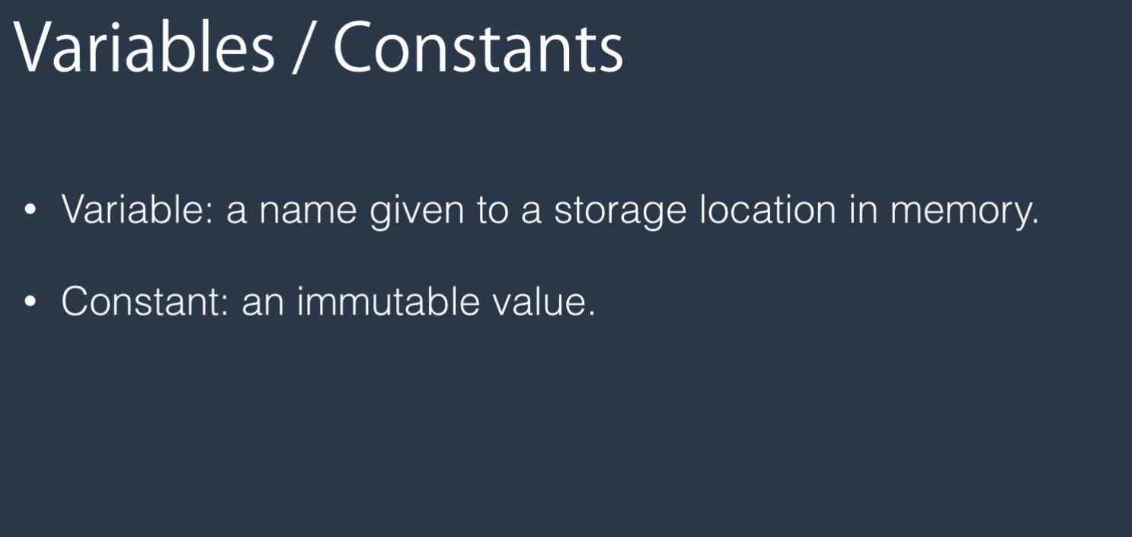
Variables and Constants
OK we are going to start our journey by learning about variables and constants.
Let's start by two definitions a variable is a name that we give to a storage location in memory where we can store a value and it can stand in any immutable value, that is, a value that we know at compile time.
And that value cannot change throughout the life of the application.
Why do we use Constants?
The reason for that is to create safety in our application.
Imagine you're creating an application that involves some mathematical computation around circles.

Slide 30

We have this number called Pi which is 3.14 and we use that to calculate the area of a circle.
That number should always be the same.
We don't want to accidentally change that in our program.
If we accidentally change that, everything is going to blow up in terms of the results the program produces.
So we declare that number as a constant.
And this way we create safety in our application

Slide 31
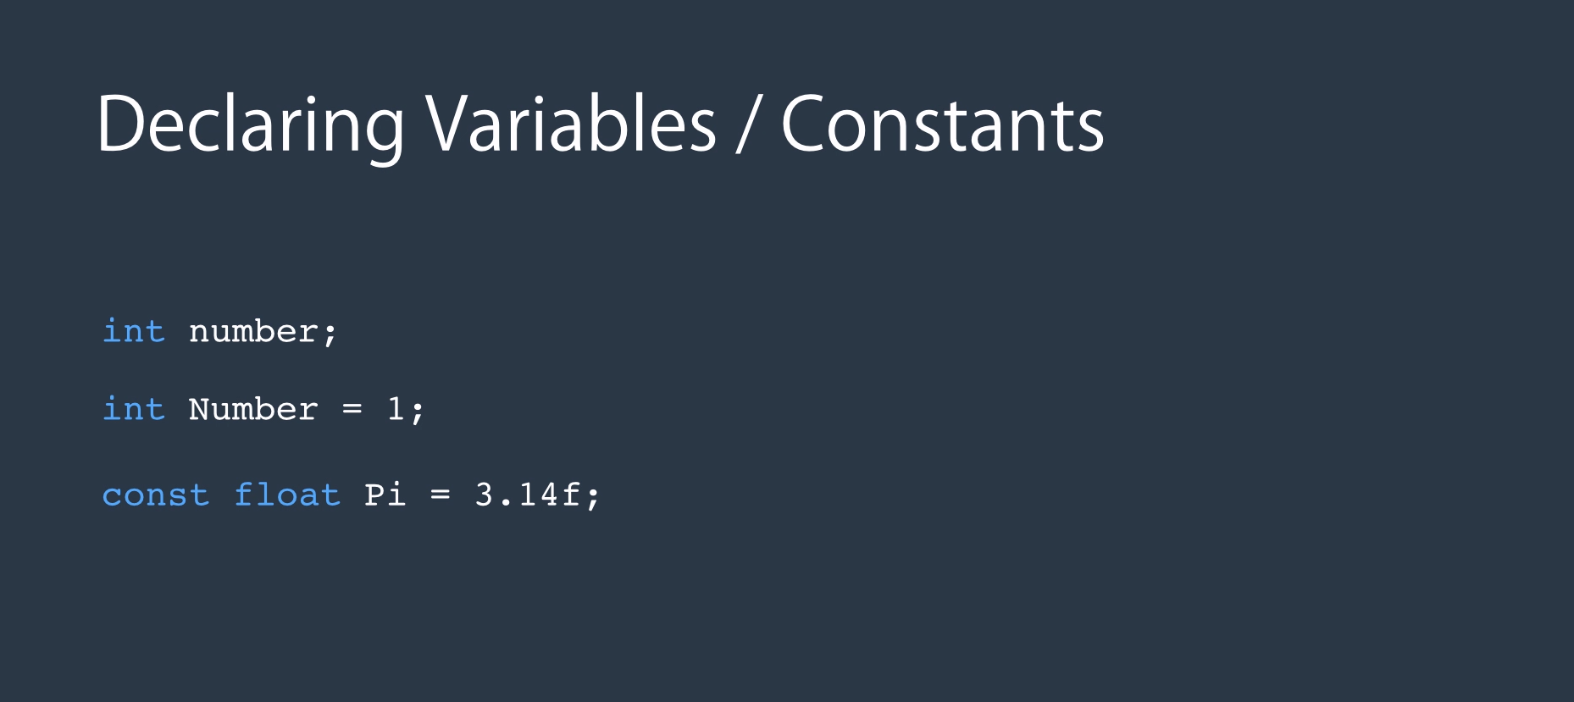
In C-sharp to declare a variable. We start with a type followed by an identifier and finally semicolon
Here int represent integer which is a number between minus 2 billion and plus 2 billion, later in the session I will show you all the primitive types that you need to know.
Also note that C-Sharp is a case sensitive language which means in this case these two identifiers are different.
One has lower case and one has uppercase and when declaring a variable we can optionally assign it to value like what you see here.
You don't have to but there is one thing you need to know about variables and that is you cannot use a variable unless you initialize it.
So let's say if I declared this number here and I decide to displayed on the console my application, it will not become part. I have to assign it a value before I can use it, before I can read it. I will show you that later when we jump to coding.
Type
Identifier
semicolon
To declare Constant we start with the key word const.
Next we have the data type and an identifier.
And here we have to initialize it with some value.
We cannot define a constant without setting its value.

Slide 32
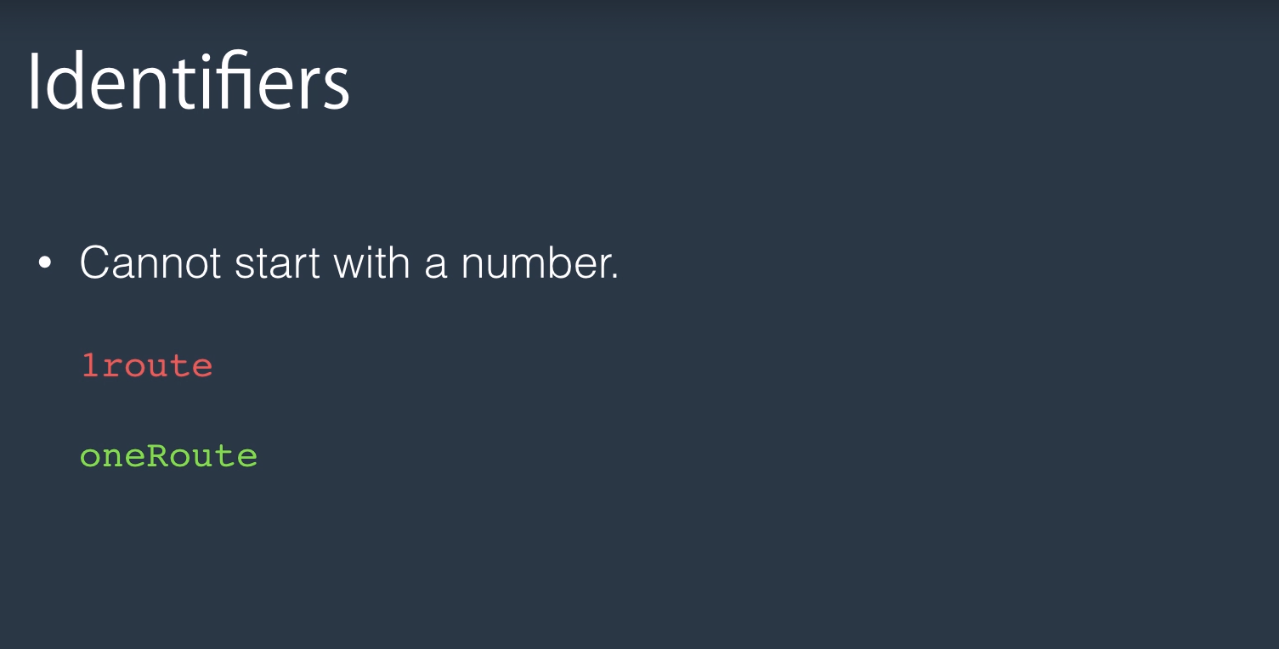
There are a few things you need to know about identifiers.
First one is that an identifier cannot start with a number.
So you cannot have an identifier like the one you see here.
Instead you need to replace 1 with the word one.

Slide 33
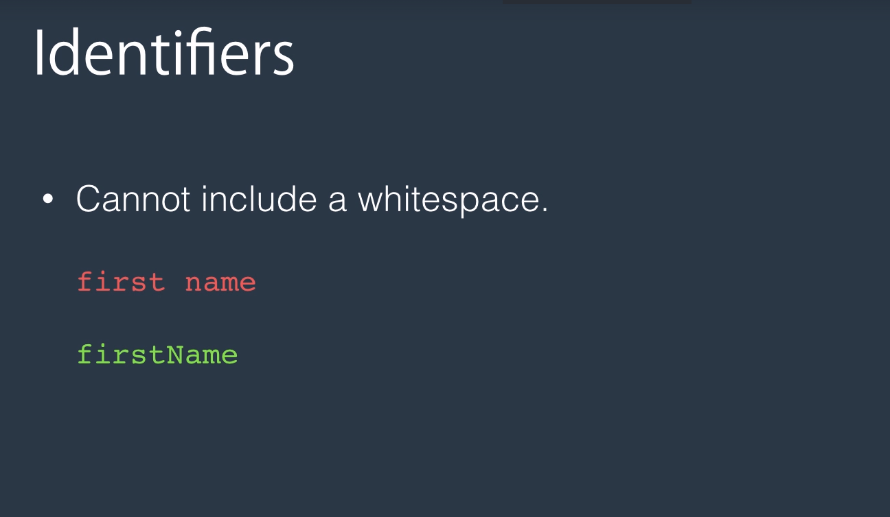
Also an identifier cannot include whitespace so you cannot have an identifier like first space name.
It has to be one word

Slide 34
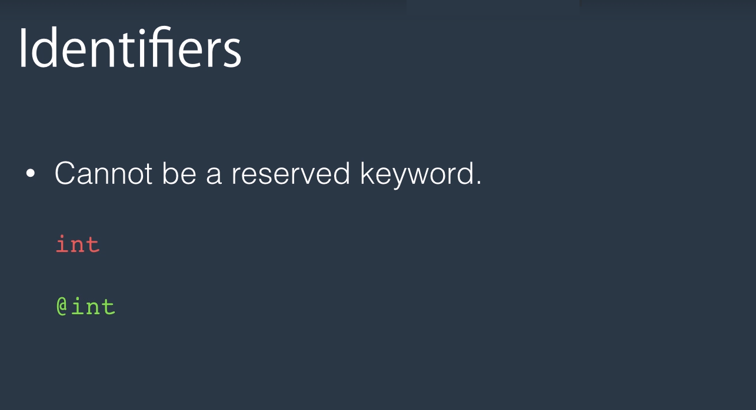
And identifier cannot be a reserve keyword like int that you saw earlier.
If you're desperate to use a word that coincidentally clashes with one of the C-sharp keywords you can preface that with the at (@) sign.

Slide 35
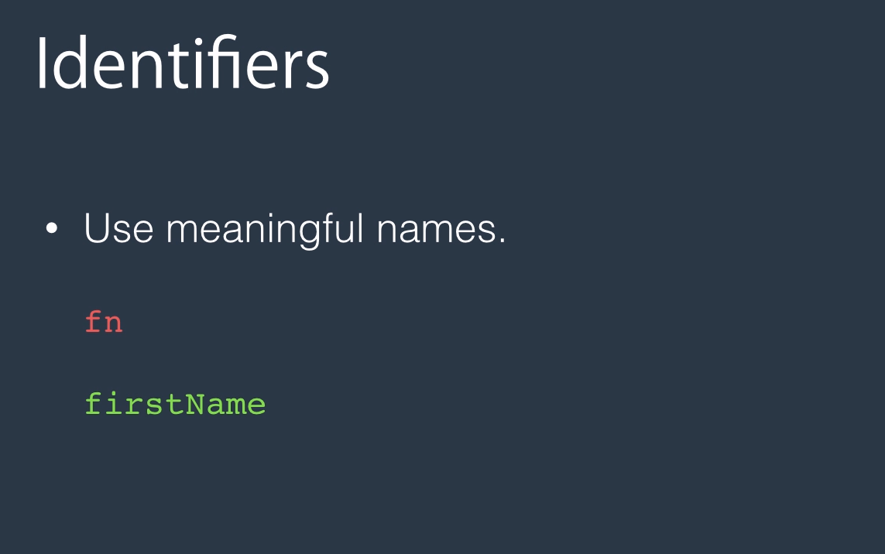
And finally as a recommendation always use meaningful names.
For example avoid a name like fn instead use firstName.
This way your code will be more readable more maintainable and cleaner
And everybody will understand that

Slide 36
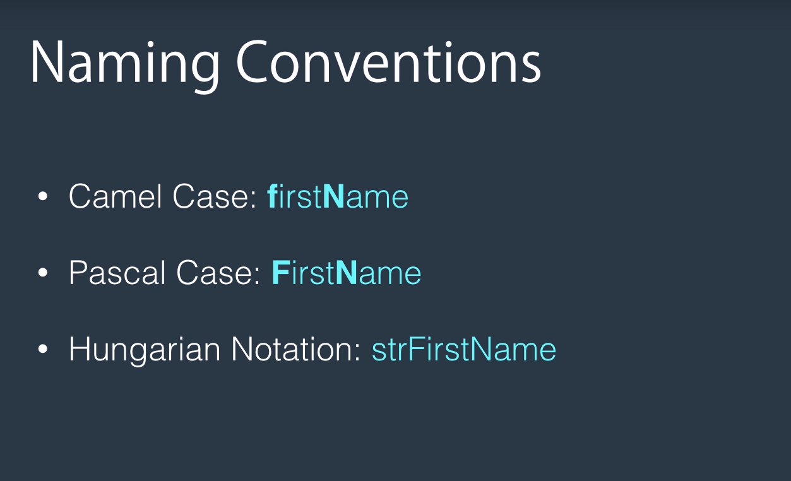

Slide 37
Continue..
In terms of naming convention. Here are three popular naming conventions that have been around in the C language family.
We've got camelCase, PascalCase and Hungarian notation
With camelCase as you see I have bolded here the first letter of the first word is lower case and the first letter of every word after it has to be upper case
With PascalCase the first letter of every word has to be all uppercase
With Hungarian Notation prefixed the name of a variable with the data type it uses.
So here str represents a string. Hungarian Notation is not used in C Sharp and I have noticed programmers coming from C or C++ might ground use that in their code.
If you're one of them I highly recommend you not to use Hungarian notation because C-Sharp developers are not used to that and they don't like to see Hungarian notation in the code. It makes your code look a little bit ugly.

Slide 38
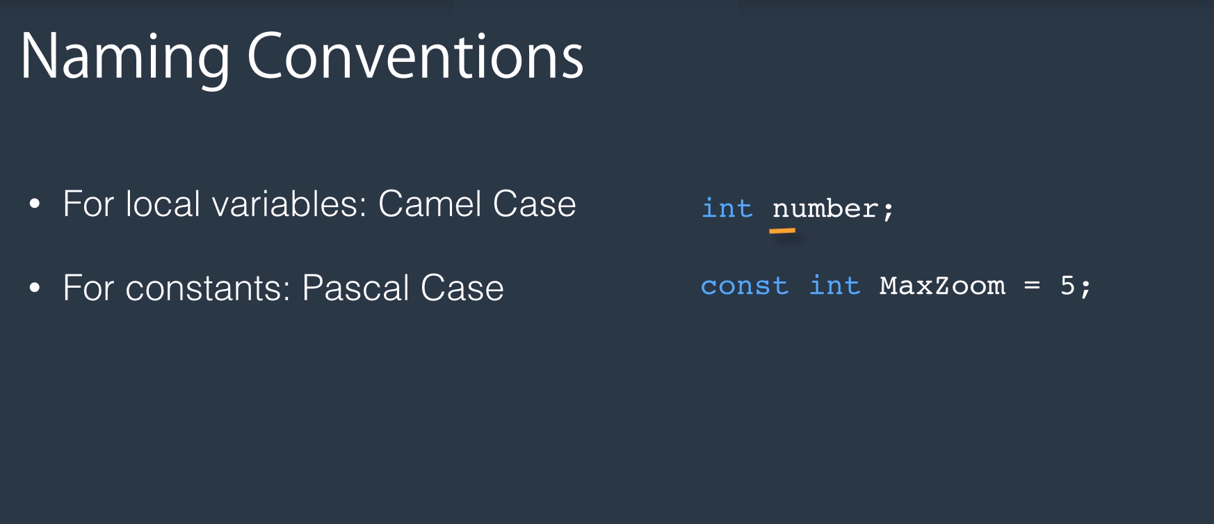
So in C-sharp to name your local variables, use camelCase.
So as you see here the first letter of the first word is lowercase and if we had more words here in the identifier the first letter of every word had to be uppercase
For constants use PascalCase.
So here you see I've got a constant here constant integer and the first letter of every word is uppercase.

Slide 39
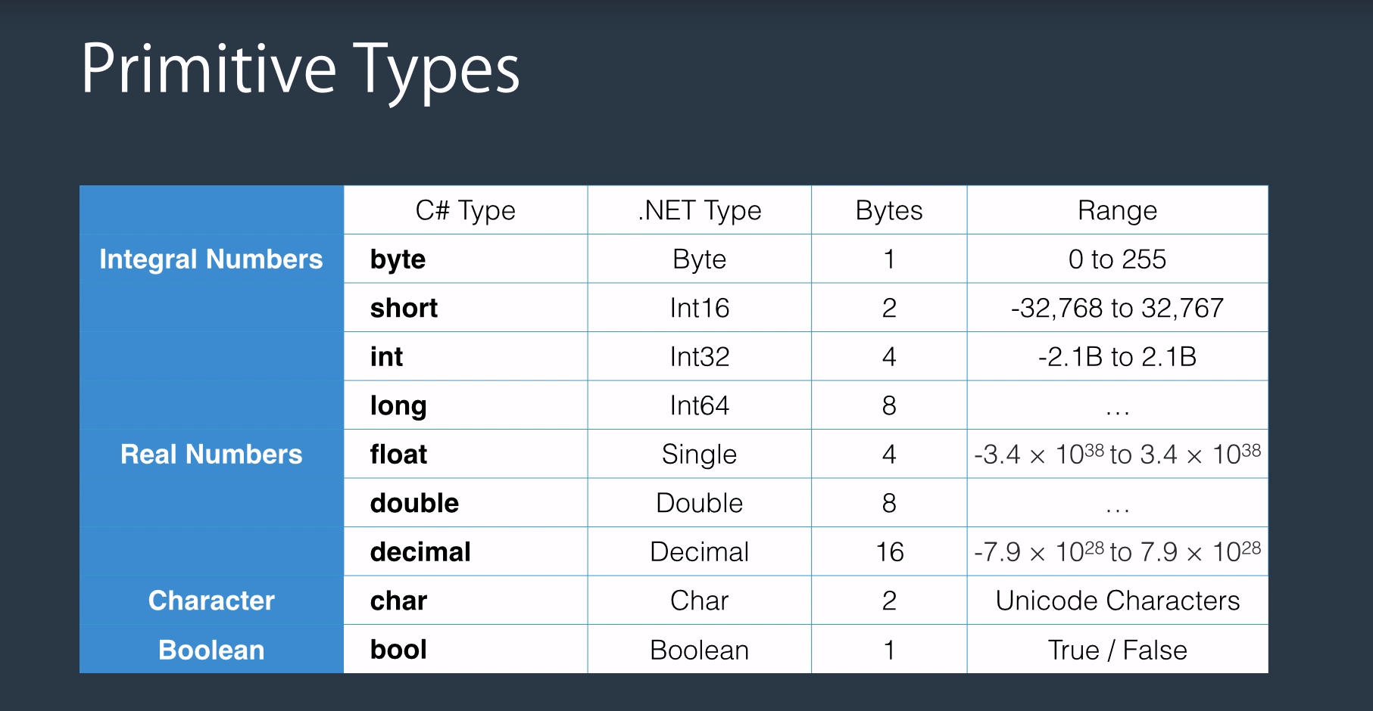
Here is the list of most commonly used primitive types in C-sharp.
In fact the actual list is slightly bigger than this but I deliberately decided not to include those data types because they're hardly ever used.
I personally over the past 14 years off me coding in C-sharp. I've hardly ever used them. In fact never.
So I decided not to confuse you with too much details that you don't need.

Slide 40
Continue..
So let's take a look at the table here.
On the flip side I have divided this data types into four categories.
Integral numbers, real numbers, character and boolean.
This column shows the C-sharp data types and these are C-Sharp keywords.
Note that the C-Sharp key words are always lower.
Each of these C-Sharp keywords or C-Sharp types maps to a type in dot net framework which is displayed
In this column so these types are part of the dot net framework.
And when you compile your application the compiler internally would translate the C-sharp keyword you use here to equivalent of dotnet type.
The third column here shows the number of bytes each data type uses.
I have listed the data types from the smallest to the largest in each category.

Slide 41
Integral Numbers..
So in the category of integral number as you see byte is the smallest.
It takes only one byte as long as the largest and it takes eight bytes the more bytes we have the more storage we have. And we can store in larger numbers.
You don't really have to memorize the range of each data type but remember byte can store a value between 0 to 255.
short can store a value between minus thirty two thousand to plus thirty two thousand
integer can store a value of between minus two billion to plus two billion
and long is even bigger than that.

Slide 42
Real Numbers
In terms of real numbers, we have three data types.
float, double and decimal
float maps to the single type in that framework and it takes four bytes. And as you see it can store a very large number.
double is twice as big so it uses 8 bytes and
decimal uses 16 bytes.
The more precision you need the bigger data type you use.

Slide 43
Character and Boolean
We also have character which is represented by C-Sharp keyword and it's two bytes. So characters in C-sharp are Unicode.
And finally we have bool which represents boolean which can be either true or false.

Slide 44
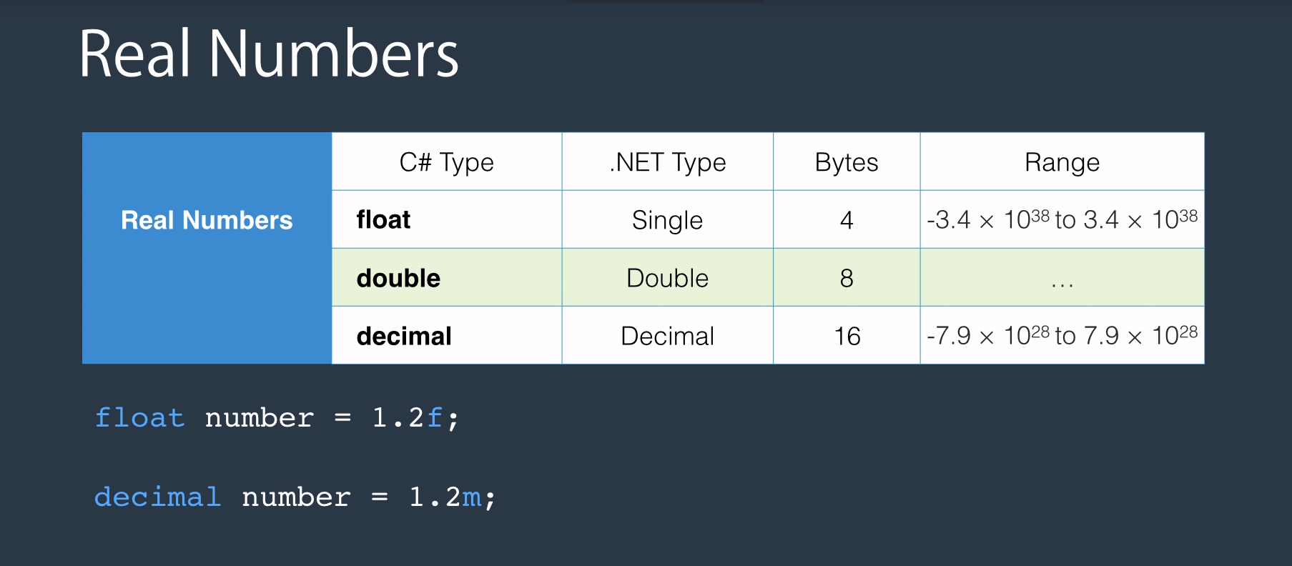

Slide 45
Continue..
Most of these data types are pretty straight forward but there is something tricky about real numbers in this table.
I have listed the data types we have for real numbers.
Load double and decimal.
I've highlighted double because that's the default data type used by C-Sharp compiler when you're using real numbers.
So if you want to declare a float you need to explicitly tell the compiler to treat the number you have as a float.
Here is an example.
I've declared a float.
Call it number assign it 1.2
Here I have added the suffix f and that is to tell the compiler to treat this number as a float.
If I didn't have this f here compiler would think 1.2 is a double because double is the default data type for real numbers.
And of course I cannot assign a double number into a float so the program would not compile.
Same applies to decimals.
So if you want to declare a decimal you need to add the suffix m at the end of the number.

Slide 46
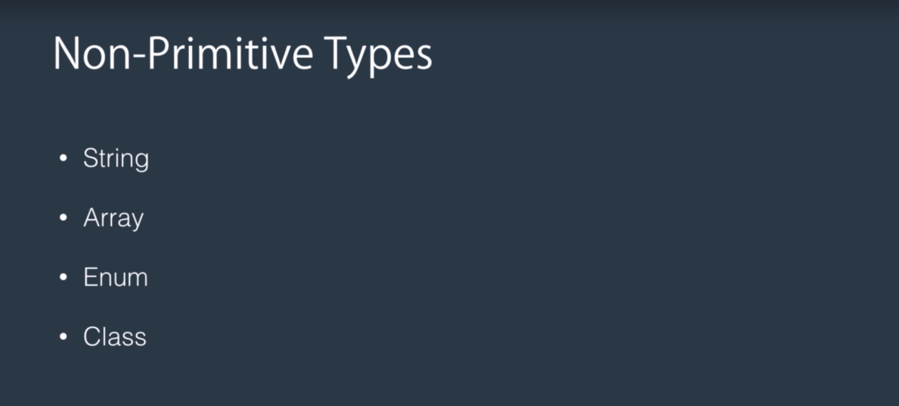
Continue..
In the C-Sharp, we also have a few other types which are not considered primitive types and there are string, array, enum and class.
You'll learn more about them throughout this course.
Now, we're going to talk about the concept of scope.
In the C-Sharp,

Slide 47
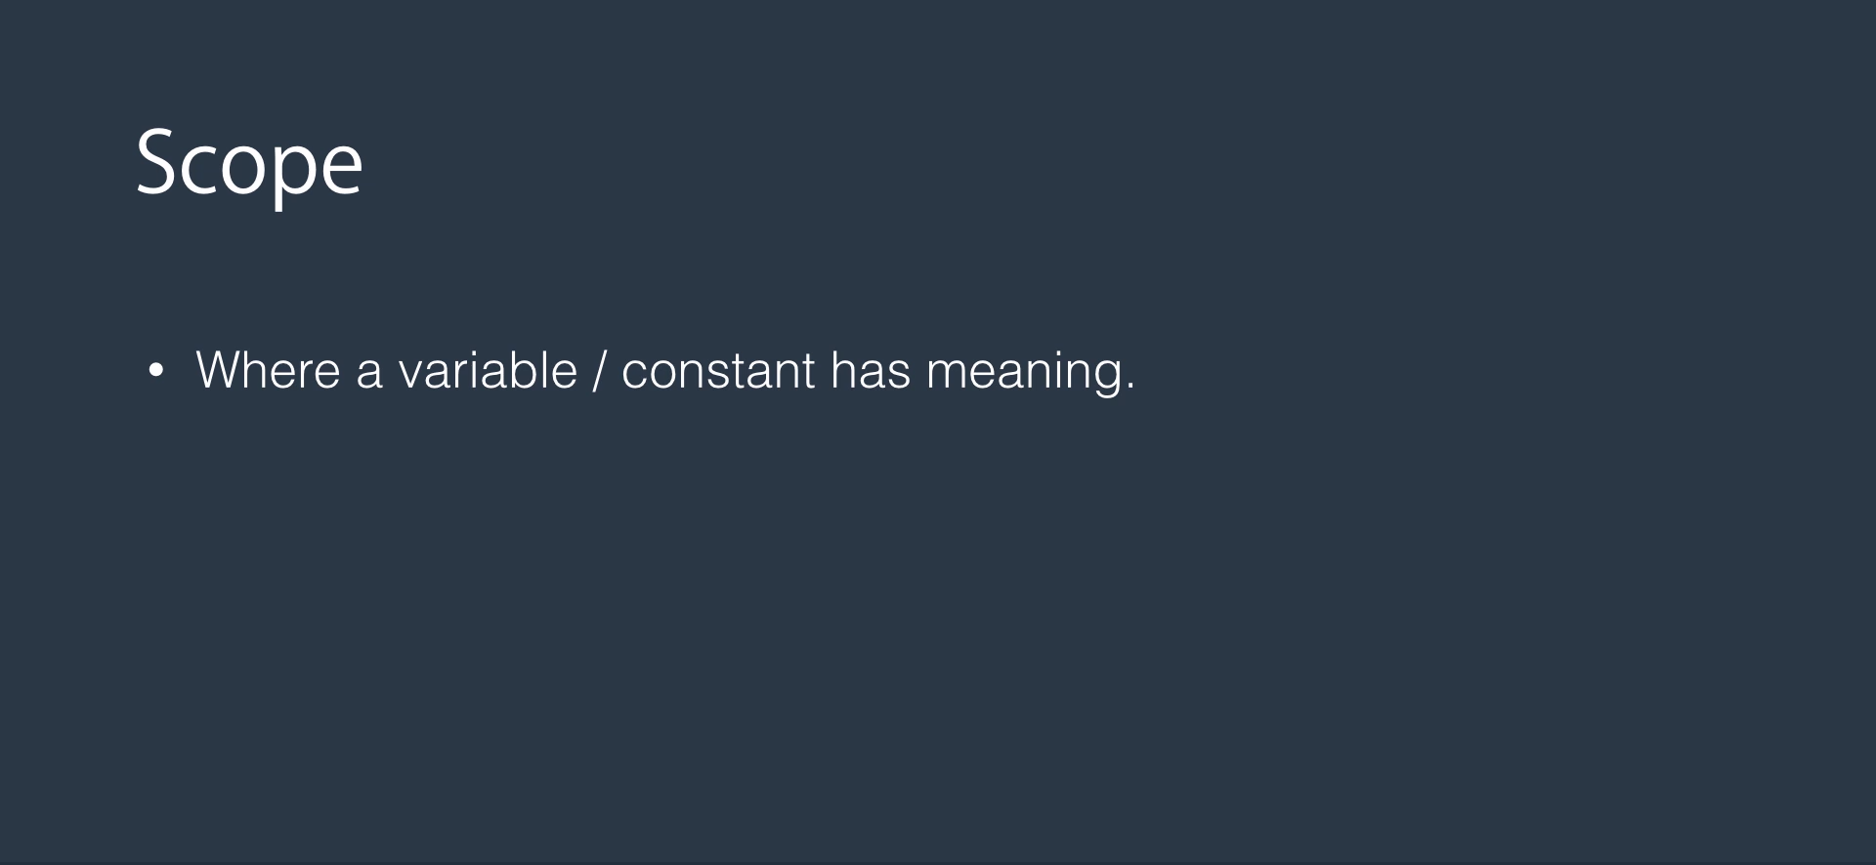
OK let's talk about the concept of scope
What is the scope?
Scope is where a variable or a constant has meaning and is accessible.

Slide 48
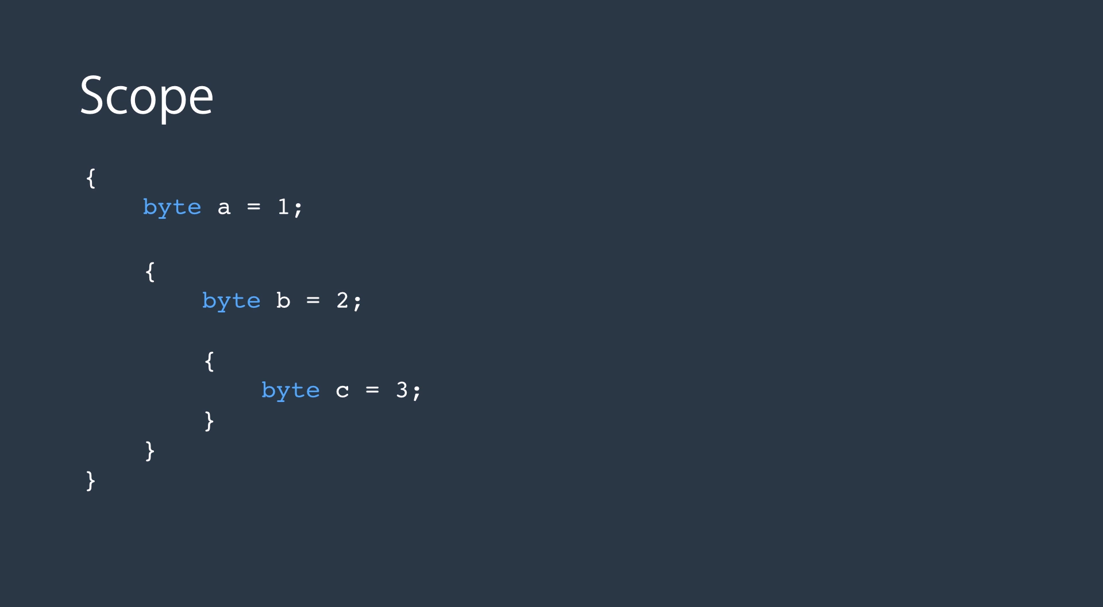
Take a look at this block of code here.
As you know a block is indicated by curly braces.
Here we have three blocks of code.
Here's one
here's another and
here's the last one in the first block.
I've got a variable called a and a is accessible anywhere inside this block or any of its child blocks.
If I go out of this block and try to access a the program will not compile
The same rule applies to other variables.
So let's take a look at this block here. b is meaningful anywhere inside this block or any of its children.
If I go outside this block and try to access b I'm going to get a compile time error.
Ok I think that's enough theory for now. Let's open our visual studio and do some coding.

Slide 49
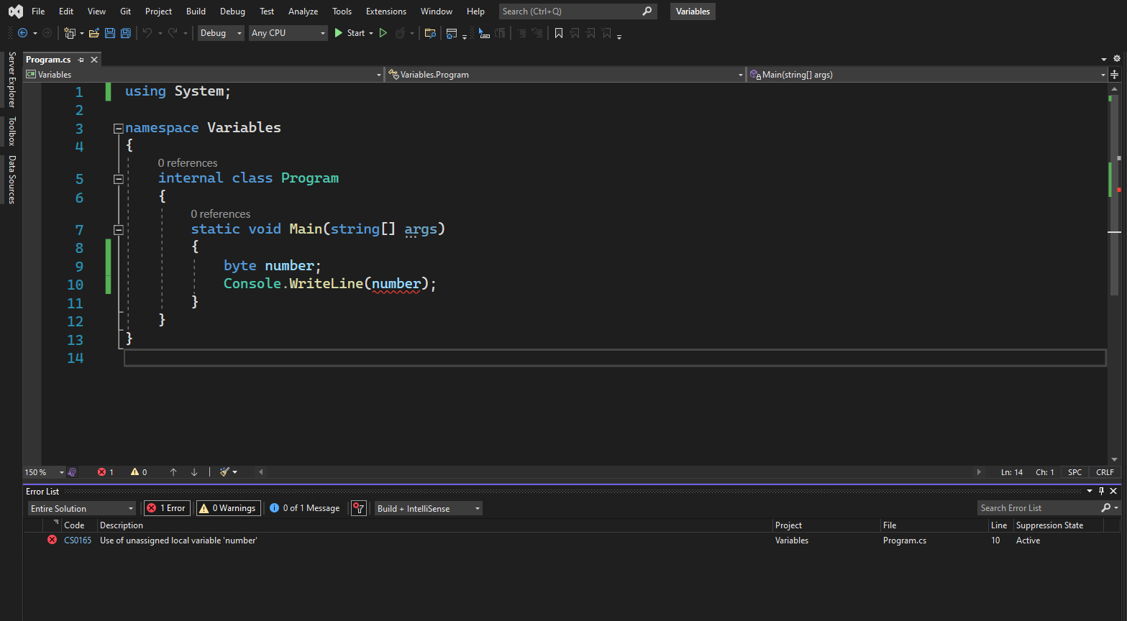
OK let's start by declaring a variable of type byte and call it number.
Now we want to display it on the console.
So as you remember that we type console.writeline input the variable here.
Using System is a namespace and Console is a class that is defined in the System namespace.
So in order to use the console class we need that declaration here on the top.
OK now take a look at this number here.
It has a red underline.
And if we put the mouse cursor here it says local variable number might not be initialized before accessing.
If you remember from the slides I told you in C-sharp before you can access a variable you need to set it in it to initialize it.
And that's the reason here we have the red underline we cannot display the number on the console before initializing that.
So if I try to compile the application we're going to get an error
to compile an application you press control shift and B.
Build: Ctrl + Shift + b

Slide 50
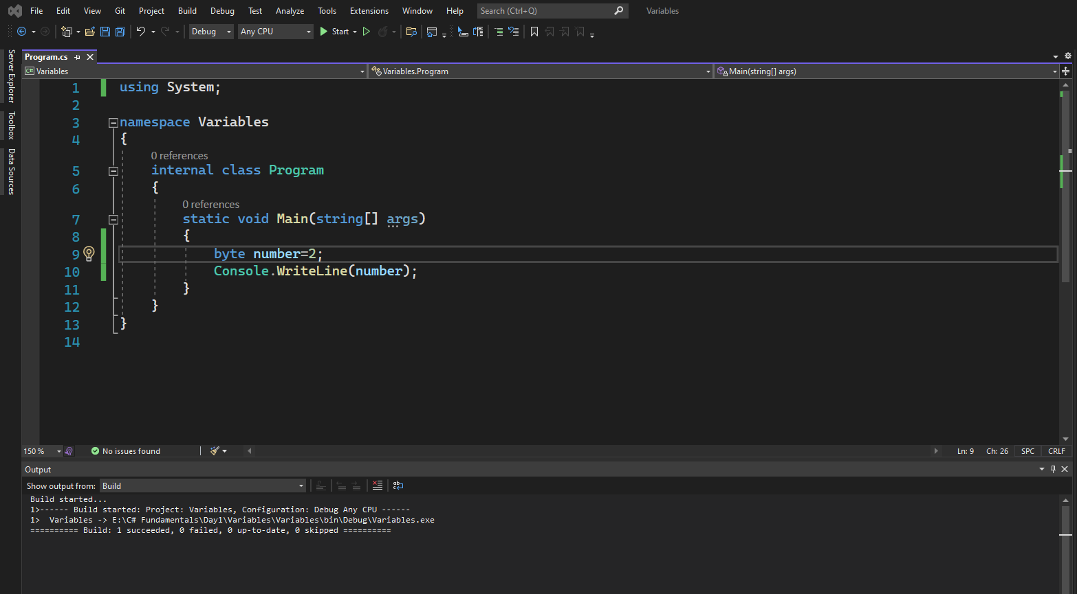
We can solve this problem by initializing number like setting it to 2 for example.
And you see the red underline is gone.
We can compile again.
Control shift B will succeed.
Take a look here.
OK.
Build: Ctrl + Shift + b

Slide 51
Now we can run the application by pressing control and F5.
OK.
Run: Ctrl + F5

Slide 52
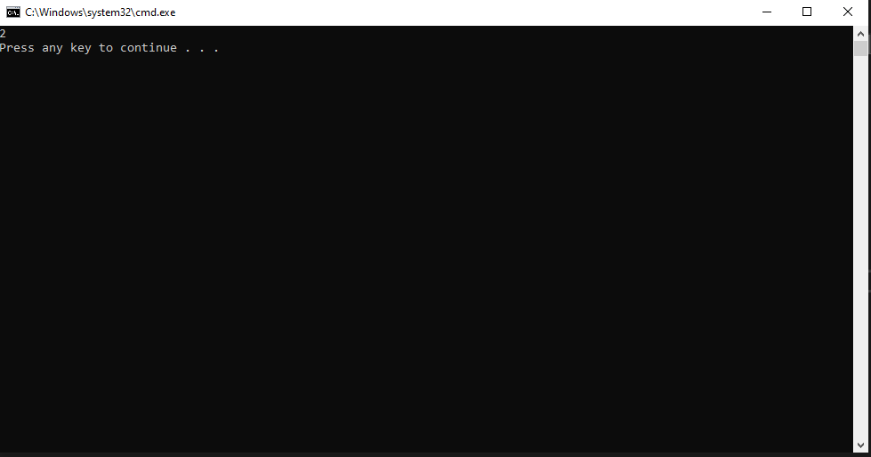
So we got two on the console.

Slide 53
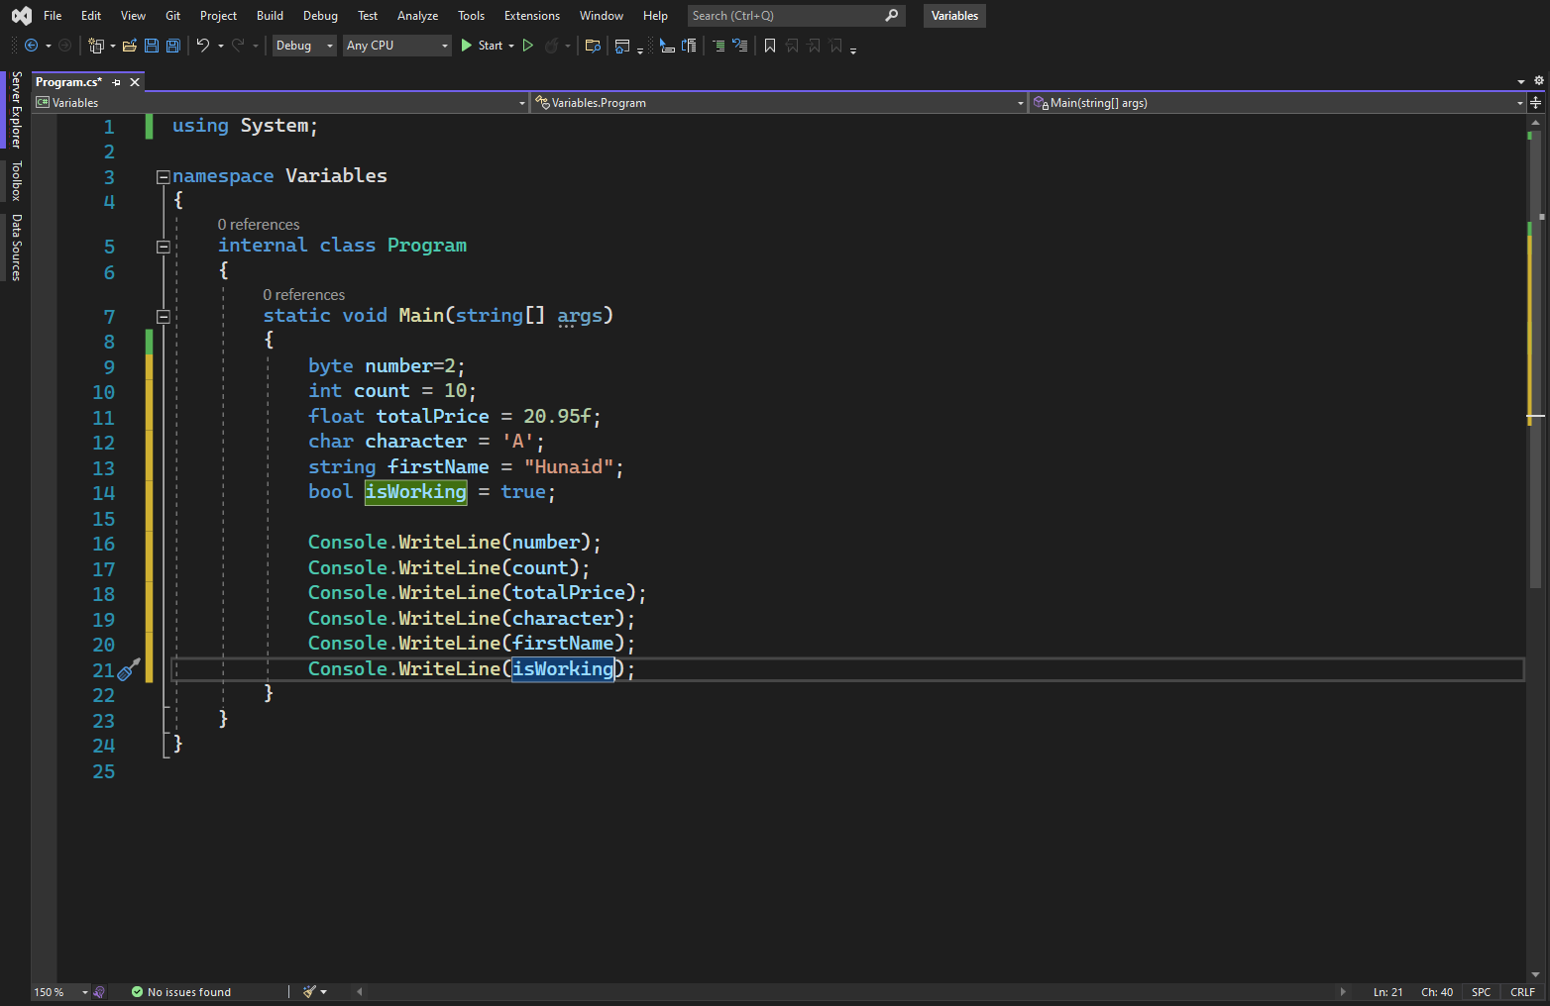
Now let us extend this example and declare a few more variables can define an integer int count equals
10 and a float float. So a total price equals twenty ninety five dollars. Now note this red underline here. Let's find out what's happening here. So I put the mouse cursor here. It says cannot convert. Source type double to target type float. If you remember from the slides I told you by default the seashore compiler traits real numbers like this one here as double where as we are declaring a float.
So here we need to explicitly tell the compiler to treat this real number as a float and we can do that by appending an F at the end. So the error is gone. Mystic inner character char character A calls a. No that is are we enclose characters by a single quote like here.
We can also declare a string string is not one of the primitive types and I have covered it in a separate lecture in this course. But for now let me show you how to declare a string which just type string. Give it a name first name a cause Marsh know that with strings being close them in double code. So that's one of the differences between strings and characters.
And finally let's declare a bool. So with bool we can either set them to True or false both true and false are Keyword as you can see they're indicated by the blue color here and they're lowercase.
So let me show you a trick. We can do a shortcut. This is what we call a code snippet.
So we type the CW that is short for console right line and then press tab and visual studio automatically converts that to console.writeline.
There are various code snippets that help you write code faster and I will try to point them out throughout this course.

Slide 54
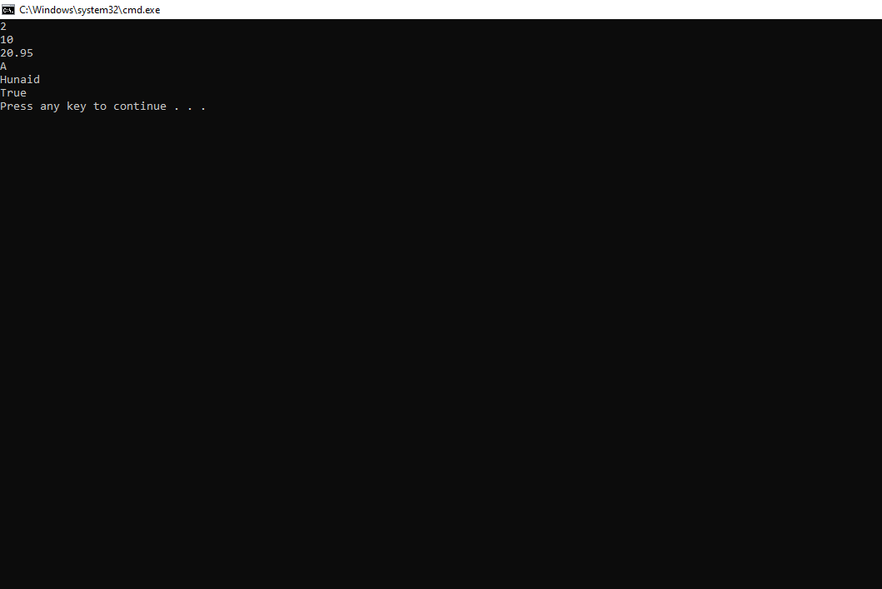

Slide 55
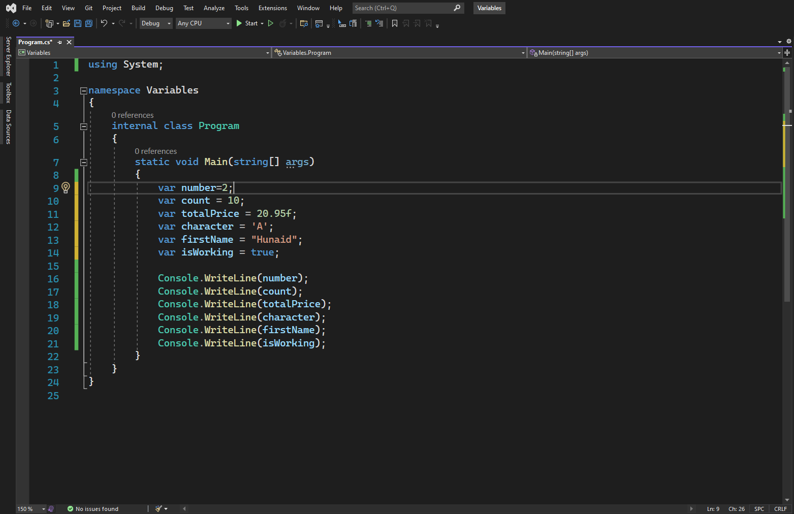
We have a keyword called var which makes variable declarations easier. For example here instead of explicitly specifying the data type for each of these here I can simply type var and I let the C-sharp compiler detect that data type for this variable here. So let me replace all of this with var.
OK now if you hover the mouse over the var keyword we can see the underlying data type. And in this case it is system that boolean which is the dominant type which maps to C-Sharp bool keyword.
And this one is a character and this one is system that single which maps to float in.
And in the case of count it's in 32 which is integer and same for number.
So the tricky thing here is by default C-Sharp creates integral numbers as integer.
And when you use the VAR key word it assumes that it's an integer.
If you really want to go for a byte then you have to explicitly say mystified as byte here but tell you from experience it's safe to use integer.

Slide 56
Continue..
In most cases in fact if you look at the classes in the dotnet framework in most cases integer is the data type used for representing integral numbers. OK I reverted back. Now I show you something else. So let's take a look at this one here. So it's a char which is a character we can put the mouse cursor here and press control and then click that opens the object browser window.
Take a look here is Object Browser and it's a way to look at the various classes in your project or in the top that framework.
In this case because I did a control click on the char or var keyword.
This is what we got here. So char is highlighted in the ogic browser on the right side you see all the members of the char type.
So these purple ones are functions or methods. If you scroll down here you'll see two fields here min Value and max value. We'll explore them shortly and note that here is the declaration of char, char is a structure we will cover as structures later in this course.
And note that it's a member of System namespace. You can click system and that shows the System namespace as well as all the types defined in the System namespace. So these are part of the dotnet framework. OK let's close this for now.
Let's explore another example.
So I'm going to get rid of all the code here we because simply press control X on each line and that deletes all these lines here. OK let's do it.
Console.write line. So CW tab this time I pass a string here and you specify two placeholders and finally supply a couple of arguments.

Slide 57
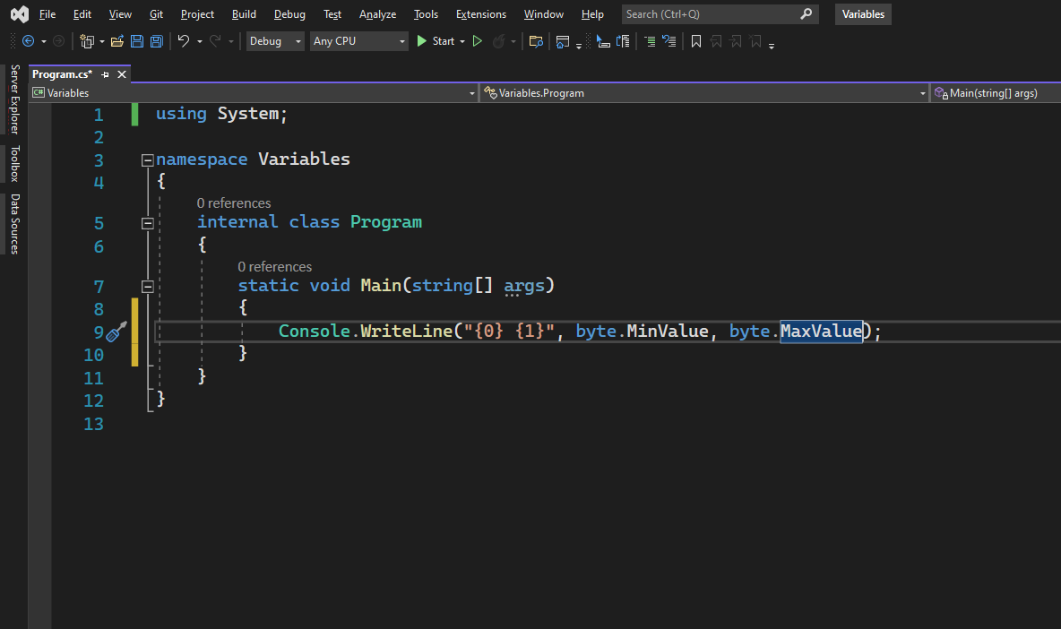
OK let's see what's going on here. So here what we have is called a format string. It's a kind of string that can be used as some kind of template. So at runtime what we have here indicated by curly braces and zero as the argument will be replaced by the value we pass here.
So 0 represents the first argument after this format string and one represents the second argument after this format string in this case byte the next value.
So let's run this application.

Slide 58
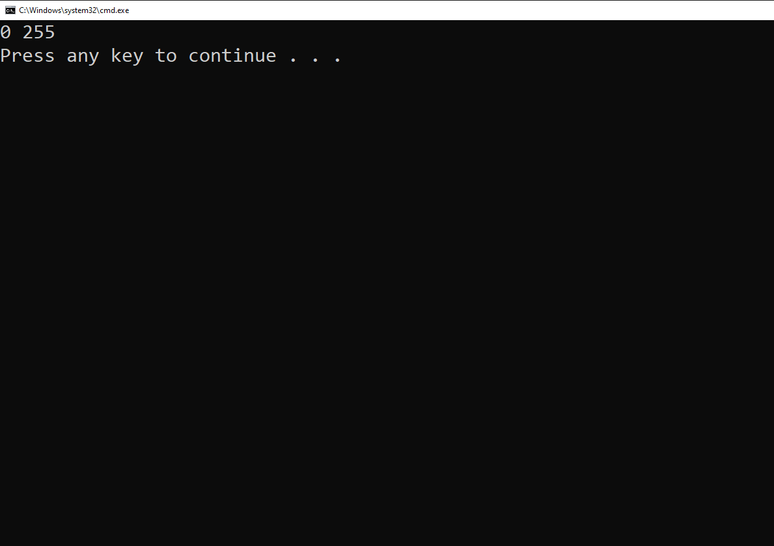
We got 0 and 255 and that's the range that you can store in a byte.

Slide 59
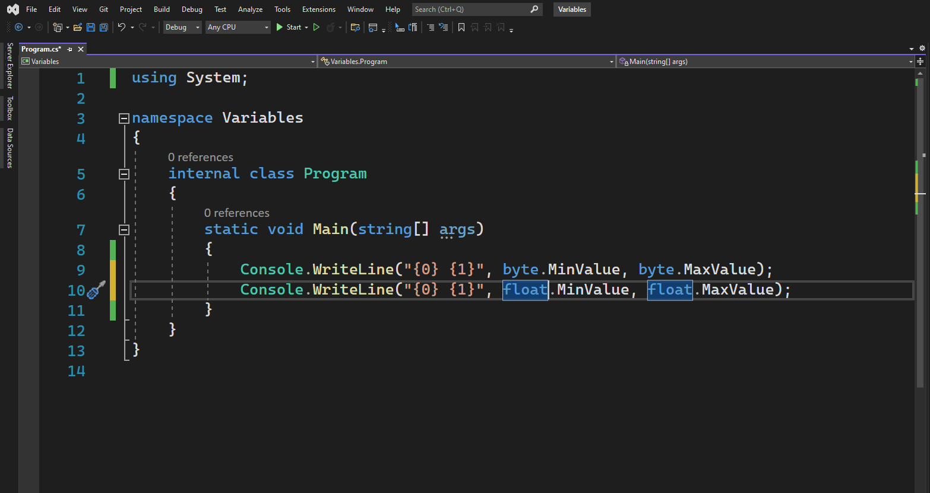

Slide 60
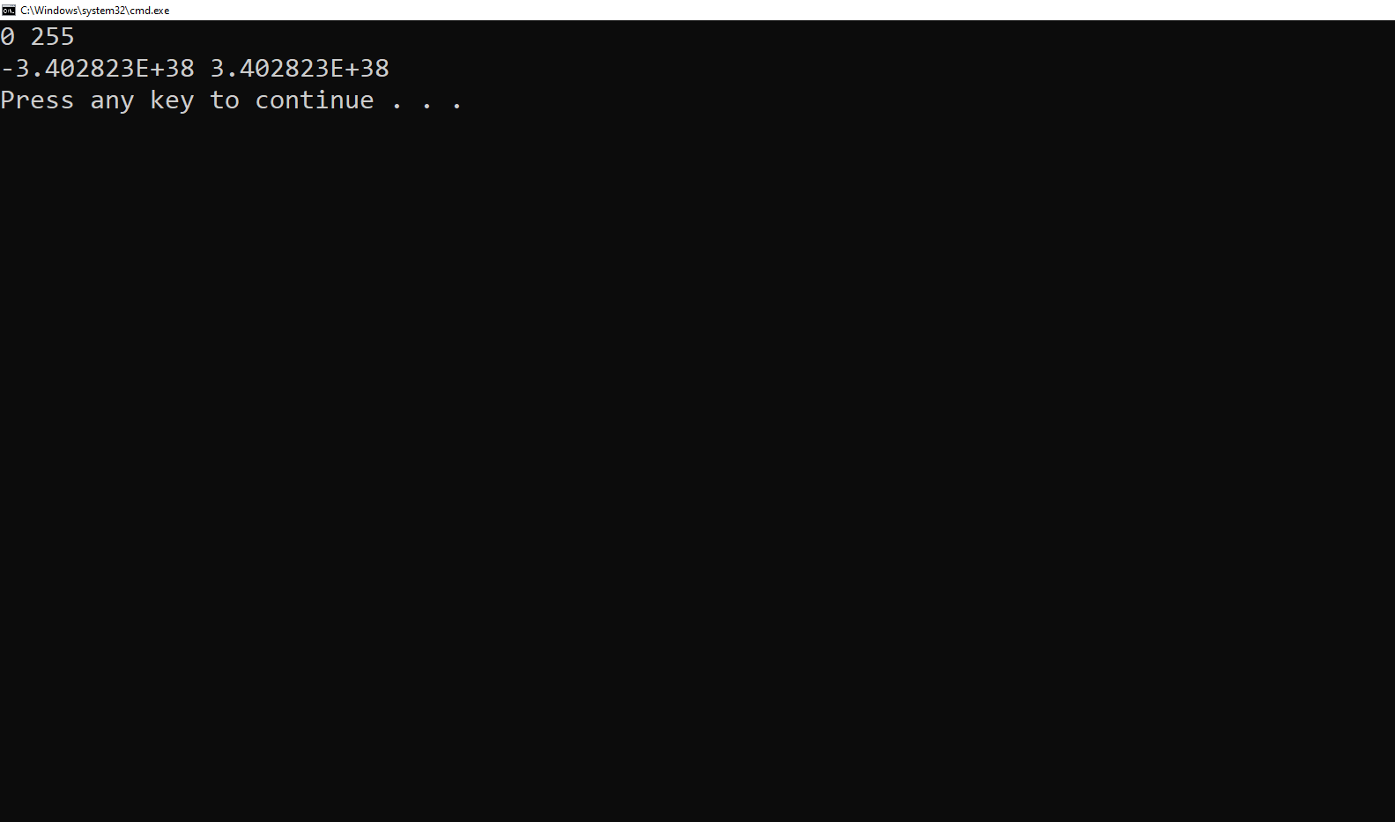
We can do the same with the float.
So CW tap a format string
float mean value float max value.
Run the application.
So this is the range we can store with a float.
It's a huge number that is displayed using the scientific notation.
OK now let's take a look at constants.
So I get rid of these two lines here.
Control X control X we define a constant with the const keyword Const float P three point 1 4 and we have to put f at the end because it's a float.

Slide 61
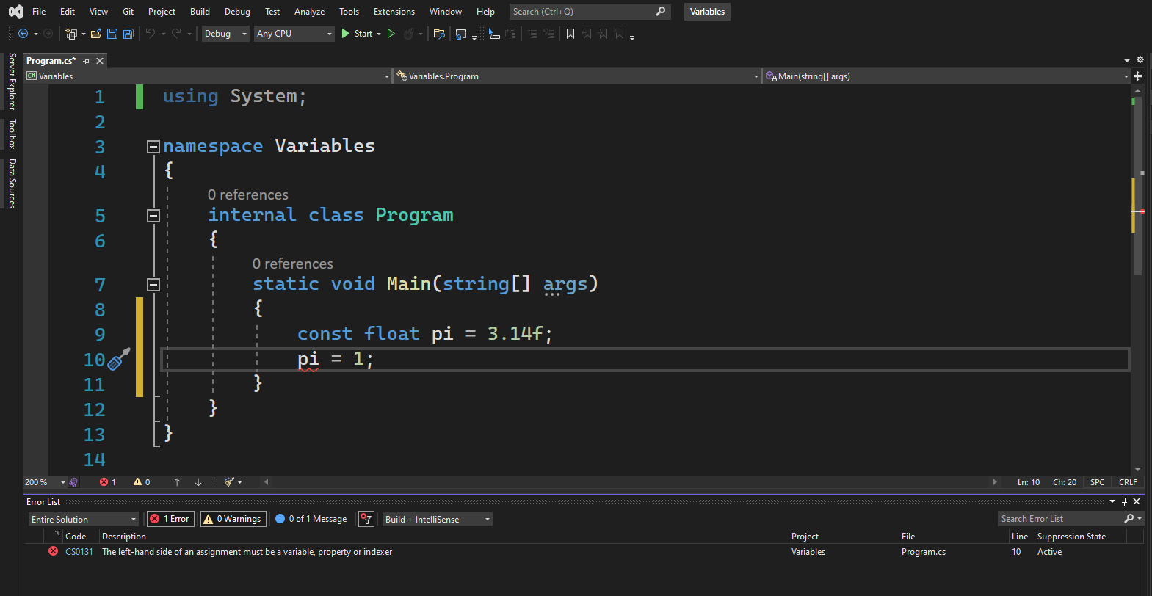
Now because we declared pi as a constant here I can change it in my program so I can go here and say pi is equal to one.
The compiler is not happy and that's why we see that red underline here. If you hover the mouse here it says read only local content cannot be used as an assignment target.
It's a little weird expression to understand but basically the intention of using constants is to have some kind of safety in your program.
So if there are values that should not be changed beyond your program you defined them as constants. And this way you won't accidentally modify their values

Slide 62
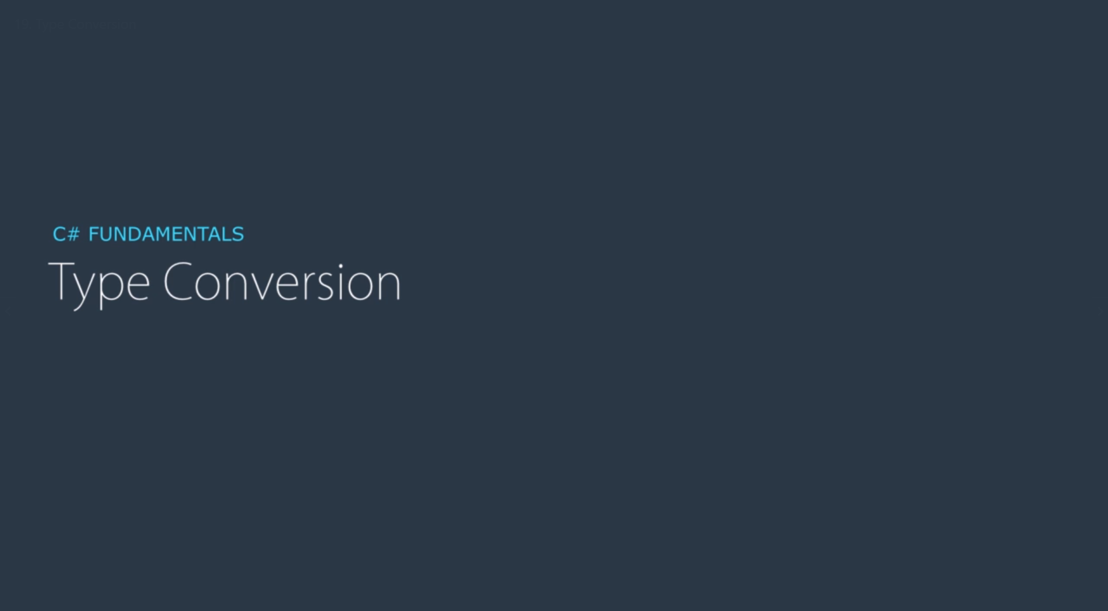

Slide 63
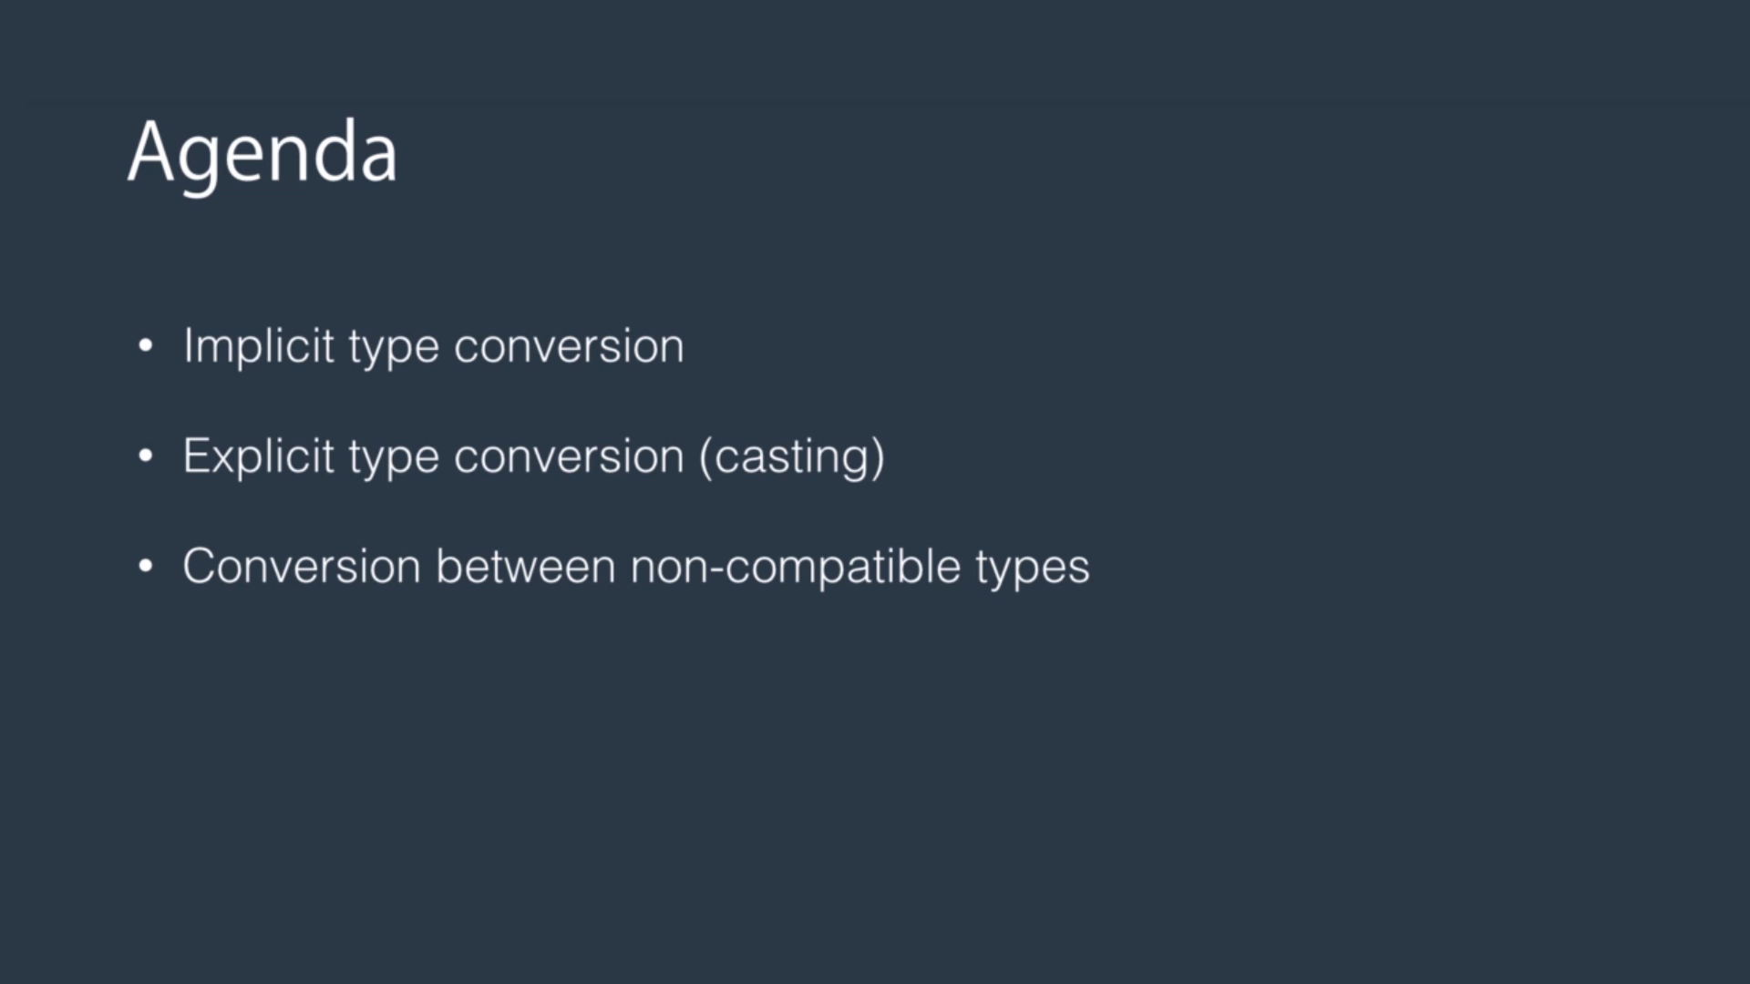
Let us talk about various kinds of type conversion in C-Sharp
we have
implicit type conversion
explicit type conversion which is also called casting and we also have
Conversion between non-compatible types.

Slide 64
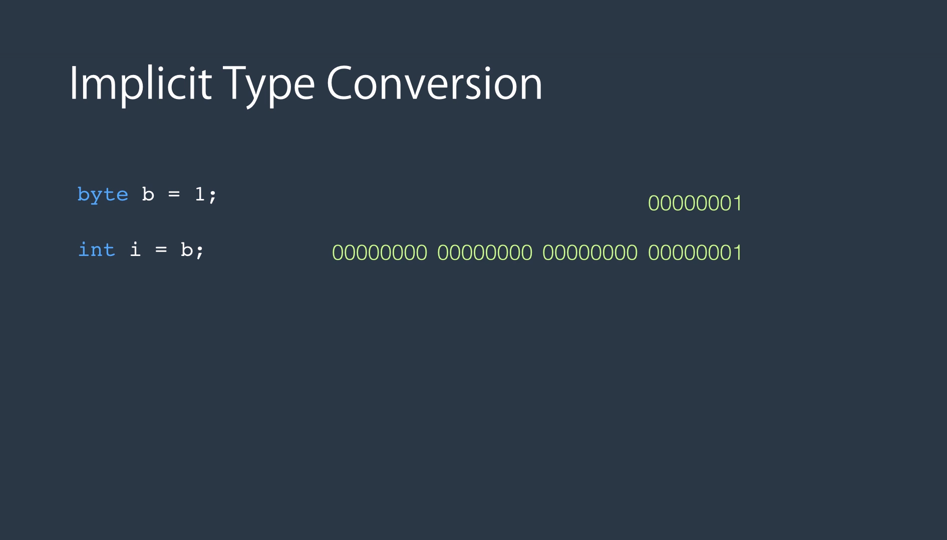
Here is an example of implicit type conversion.
A byte as you know takes only one bite of memory and an integer takes four bytes.
So we can easily copy a byte to an integer.
What happens at runtime is let's take a look at this slide.
So here is the binary representation of our b variable here.
So one is represented as seven bits of 0 and 1 bit of one.
When we copy a byte to an integer, what the runtime does is it prefixes that value with a bunch of zeros to fill the four bytes. So there is no data loss.
In situations like that when the compiler is 100 percent sure that the types are compatible and no data loss will happen.
Values can be converted to a different type implicitly.

Slide 65
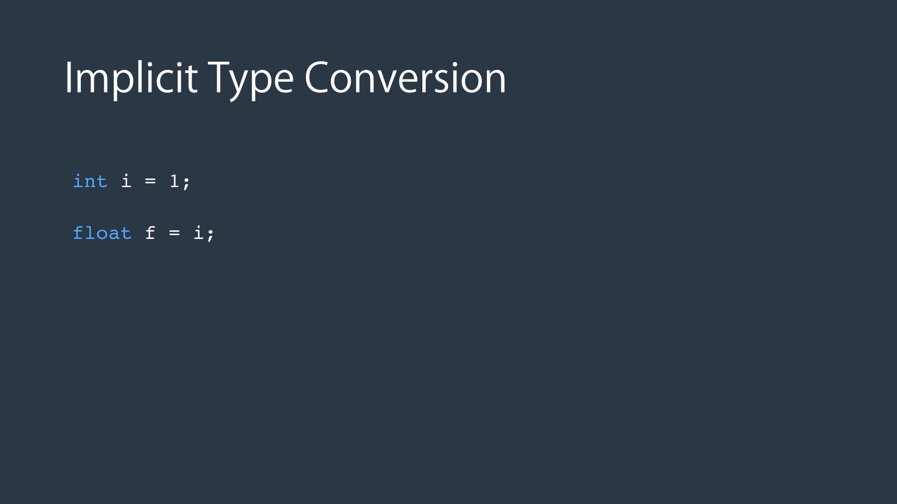
Here's another example of implicit type conversion.
So we have an integer set to 1 and we copy that to a float.
Again in this example no data loss will happen.

Slide 66
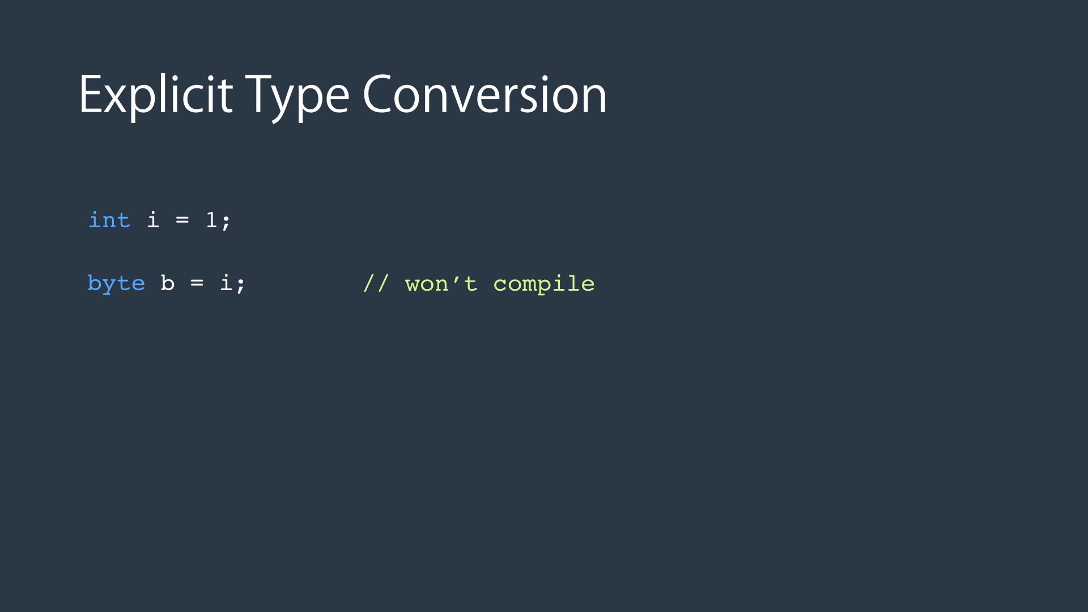
Well let's take a look at this one.
Here we have declared an integer and we are trying to copy that to a byte and integer is four bytes.
So when we convert that to a byte three bytes out of four bytes will be gone and there is a chance for data loss.
Now data lost doesn't always happen.
It only happens if the value will be stored in the integer is beyond the capacity of a byte.
In this example one can be stored in a byte so no data loss will happen.
But if we had let's say 300 here we cannot store 300 in a byte.
So as a result of that conversion they hold will lost when the compiler knows that there is a chance for data loss.
It doesn't allow implicit type conversion and you need to explicitly tell the compiler that you're aware of the data loss and you still want to go ahead with the conversion.
(Go to Next slide) In situations like that what we do is we prefix that variable with the target type. So here I'm trying to convert I to a byte.

Slide 67
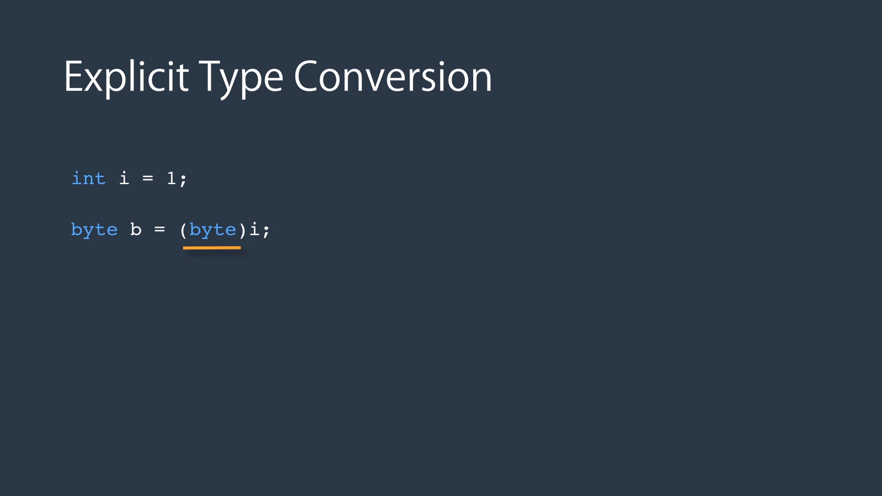
In situations like that what we do is we prefix that variable with the target type.
So here I'm trying to convert i to a byte.
This is what we call as casting.

Slide 68
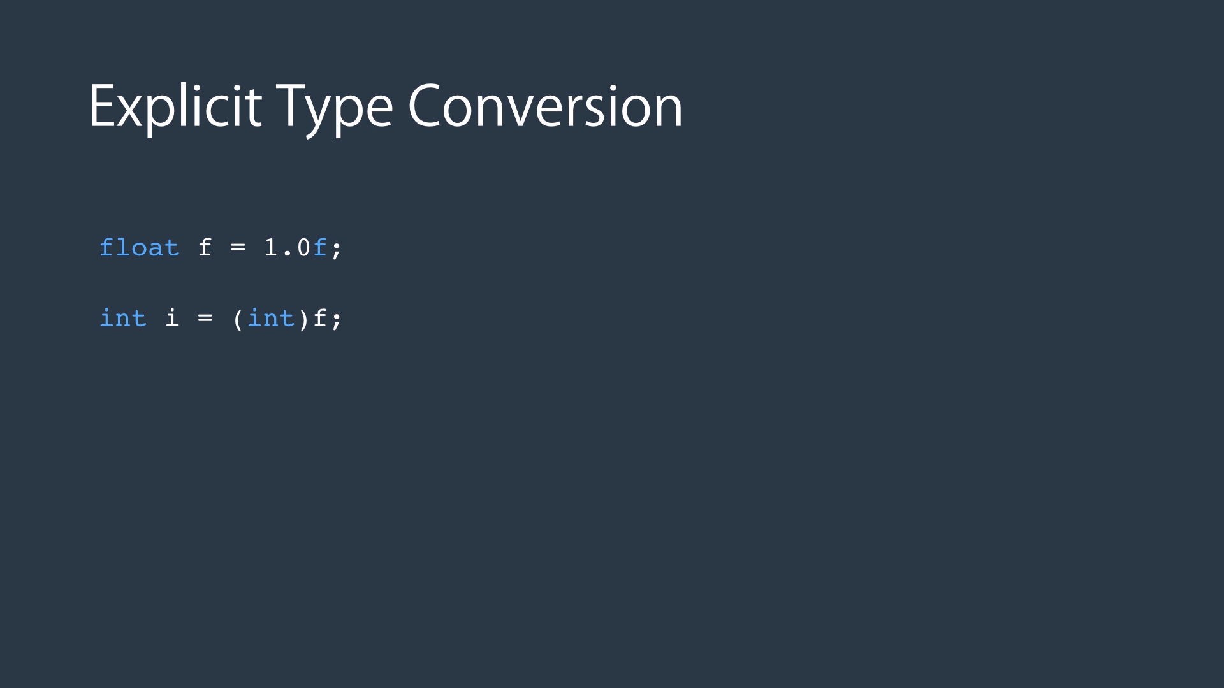
Here's another example.
So we have a float set to 1.0.
And if we try to convert that to an integer the compiler would complain.
I was sure that later in the coding demo.
So we need to tell the compiler that we are aware of the data loss and we still want to convert f which is a float to an integer.
So we cast it like here.

Slide 69
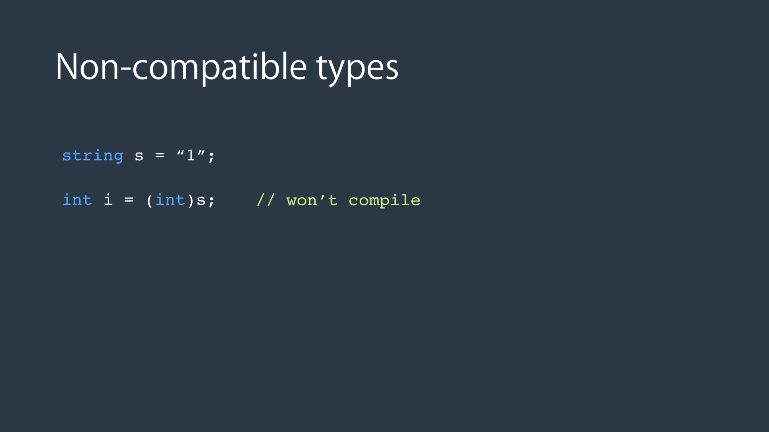
Sometimes we are working with types that are not compatible but you still need to convert them.
For example we might have a number represented as a string as you see here and we need to convert it to an integer.
In situations like that because string and int are not compatible you cannot use explicit casting.
So we need a different mechanism for converting a string to a number.

Slide 70
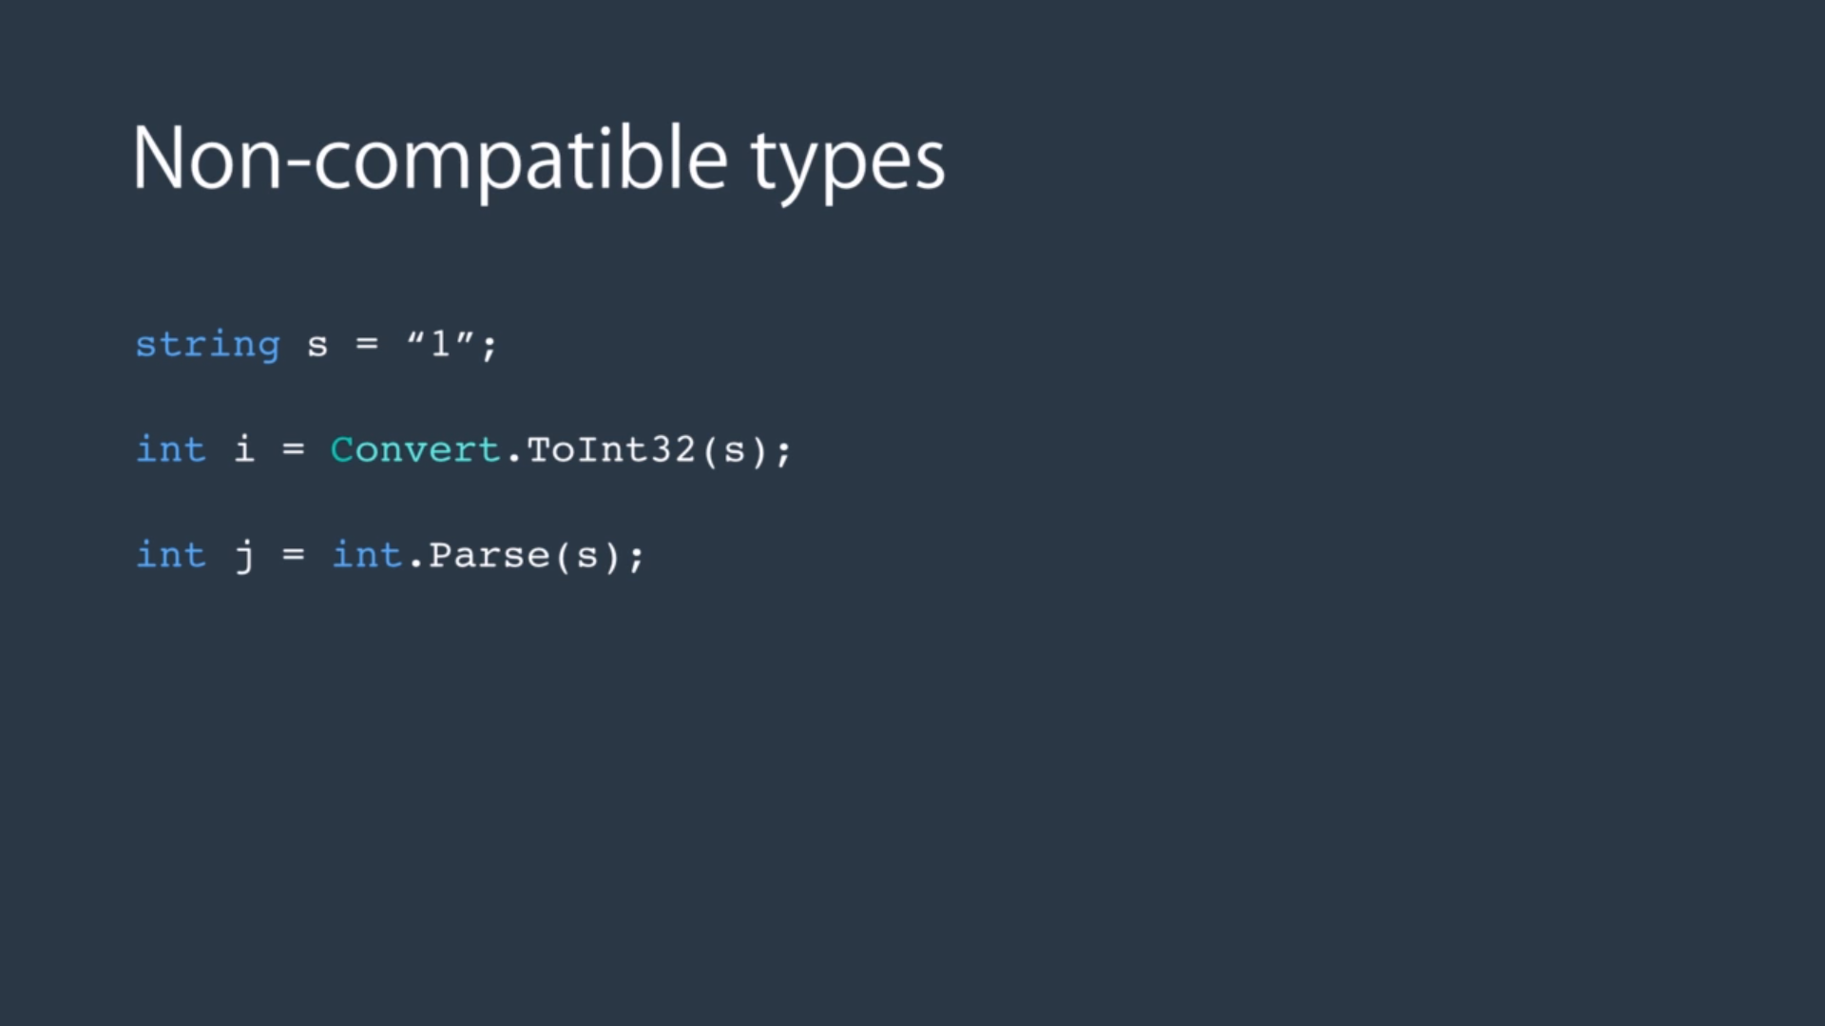
In situations like that we need to use the convert class or use the Parse method to convert classes part of data framework and it's defined in the system namespace.
It has a bunch of methods for converting various types to other types and they all start with To.
In this case we're trying to convert a string to an int 32.
Int32, As you know is a dot Net Framework type which maps to a C-sharp integer type.
Remember a byte is one byte, as short is two bytes, and integer is four byte, long is eight bytes.
You probably know that each byte has eight bits.
So an integer which has 4 bytes times eight beats ends up being 32 bits.
That's why it's called two in 32 and in 16 which represents 16 bits equals two short which is two bytes.
We also have this parse method here all the primitive types that I explained like integer, long, float, boolean.
They all have this parse method and the Parse method takes a string and tries to convert that to the target type.
In this case an integer.

Slide 71
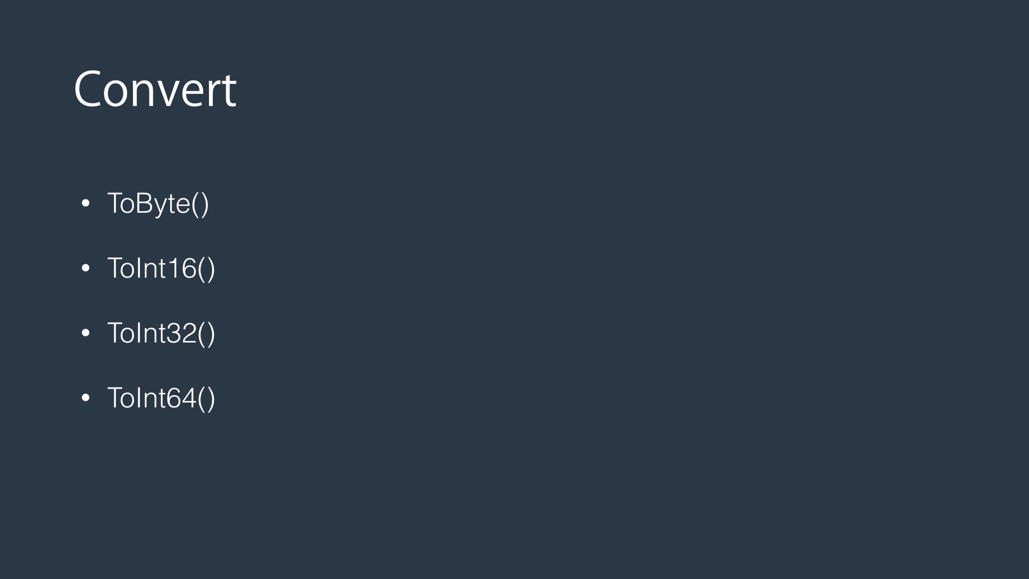
Here are some of the methods that you can find in the convert class
to byte which converts the given value to a byte
to int 16 to convert the given value to a short
to int 32 to convert the given value to an integer 32
To int 64 to convert the given value to long.
OK enough theory.
Let's jump into code and see all this concept in action.

Slide 72
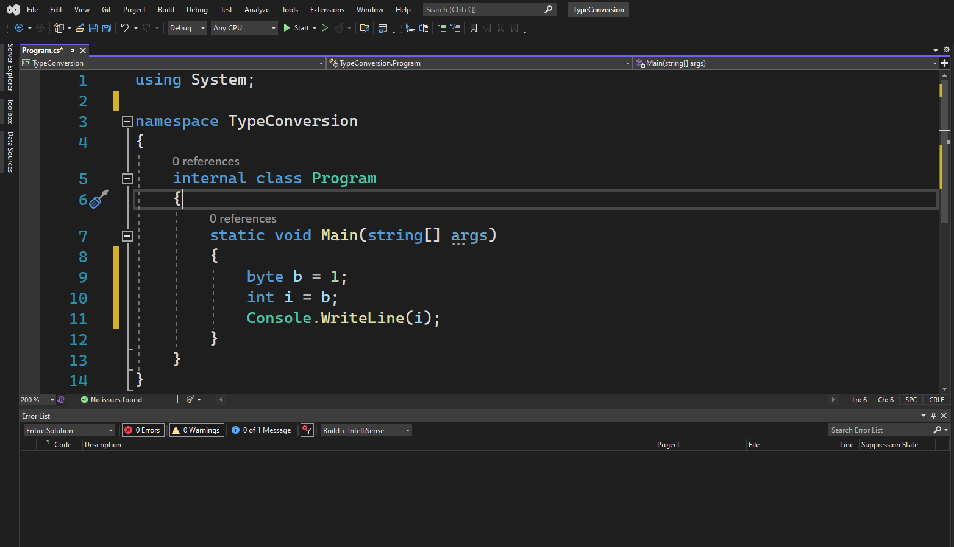

Slide 73
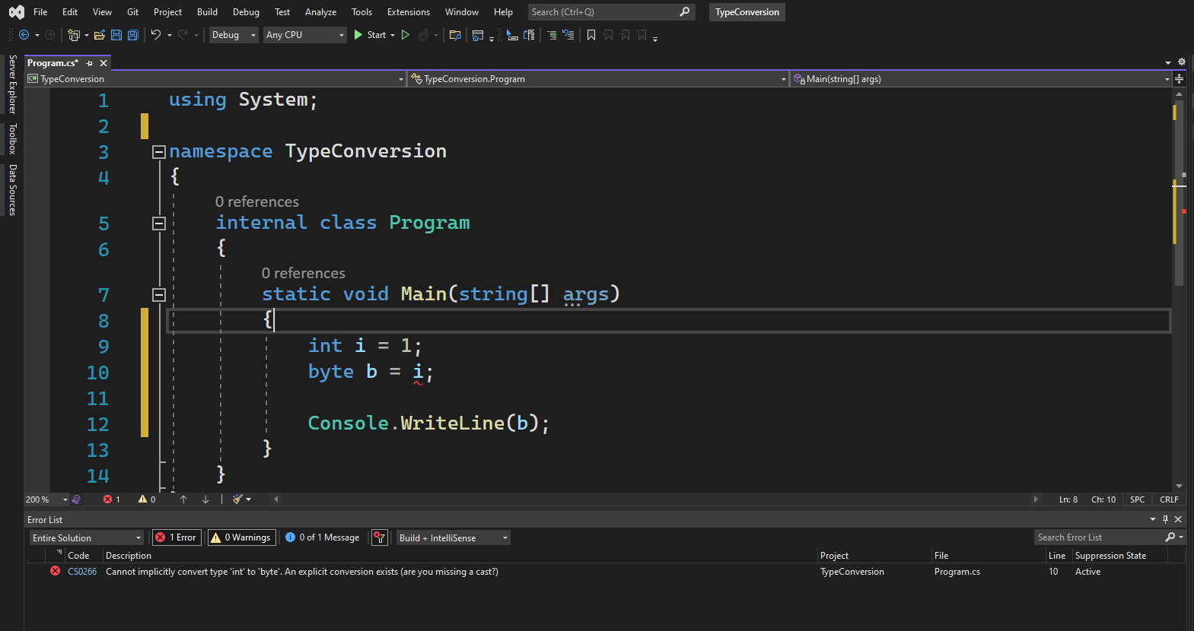

Slide 74


Slide 75
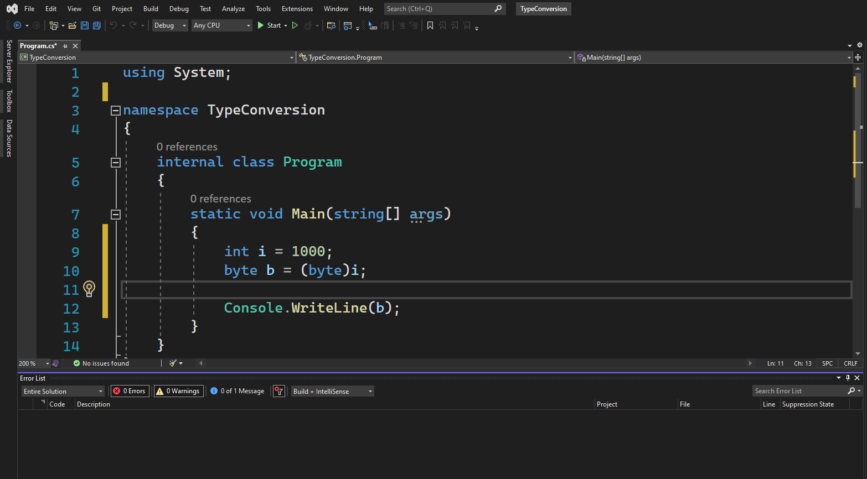

Slide 76
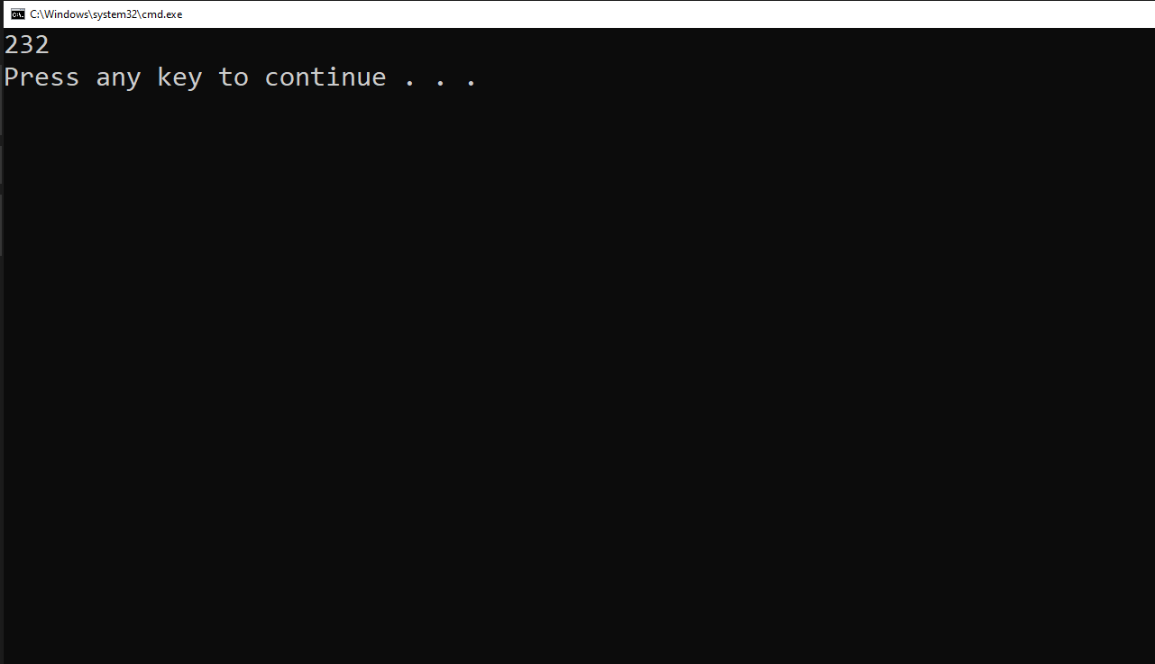

Slide 77
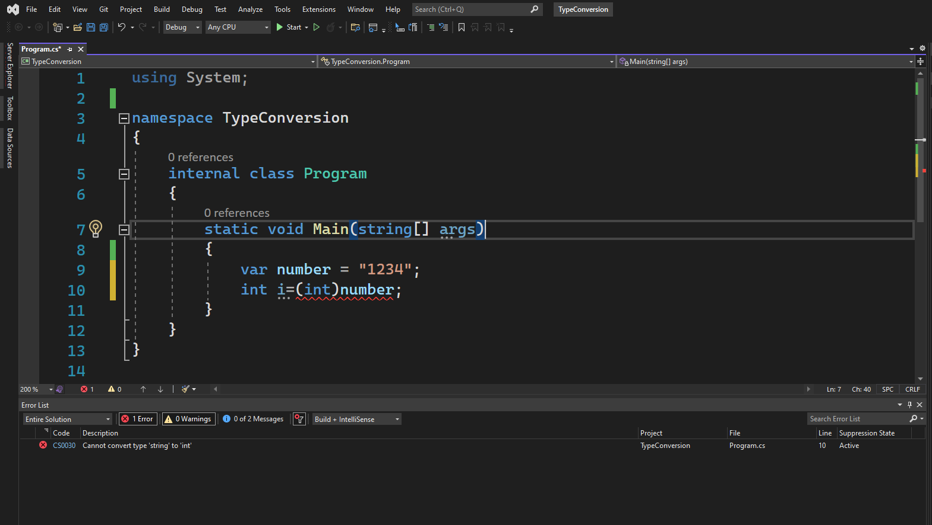

Slide 78
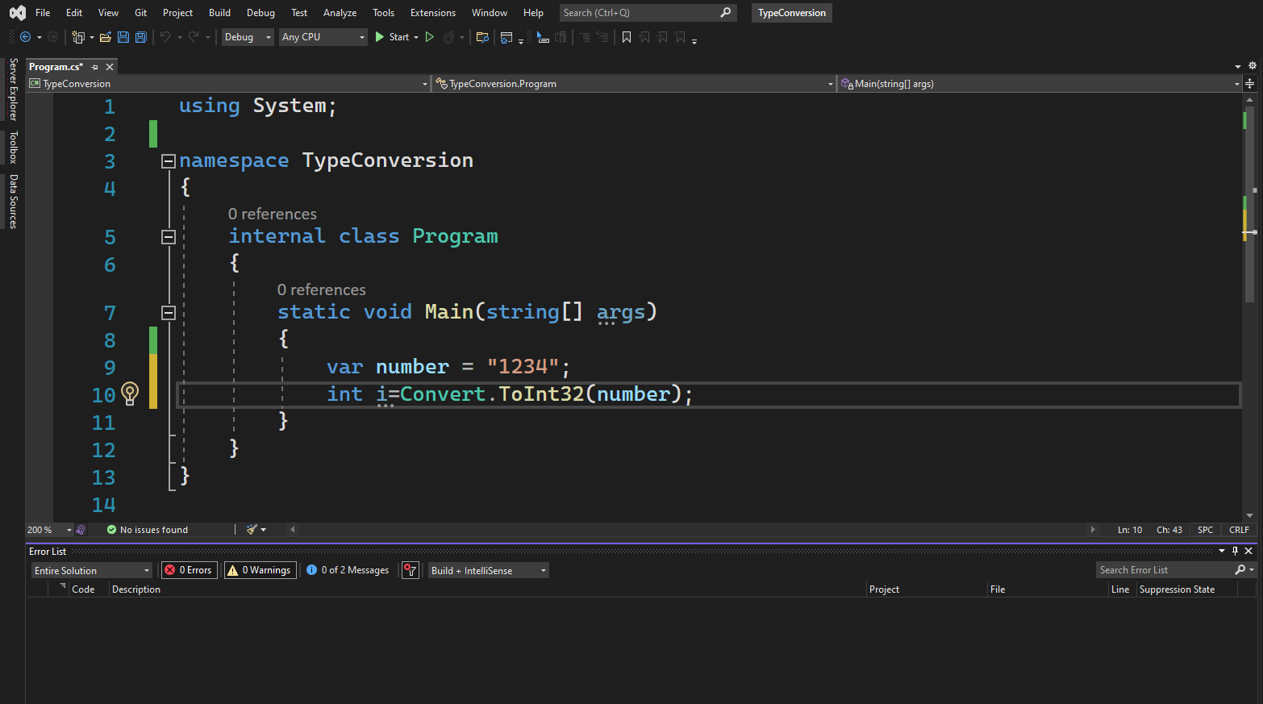

Slide 79
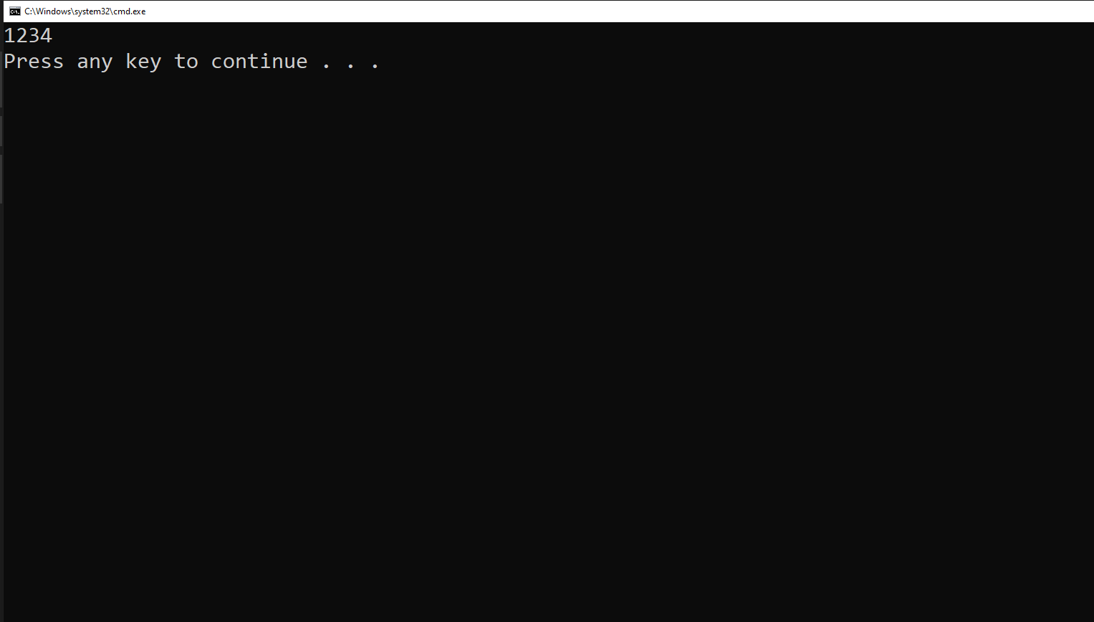

Slide 80
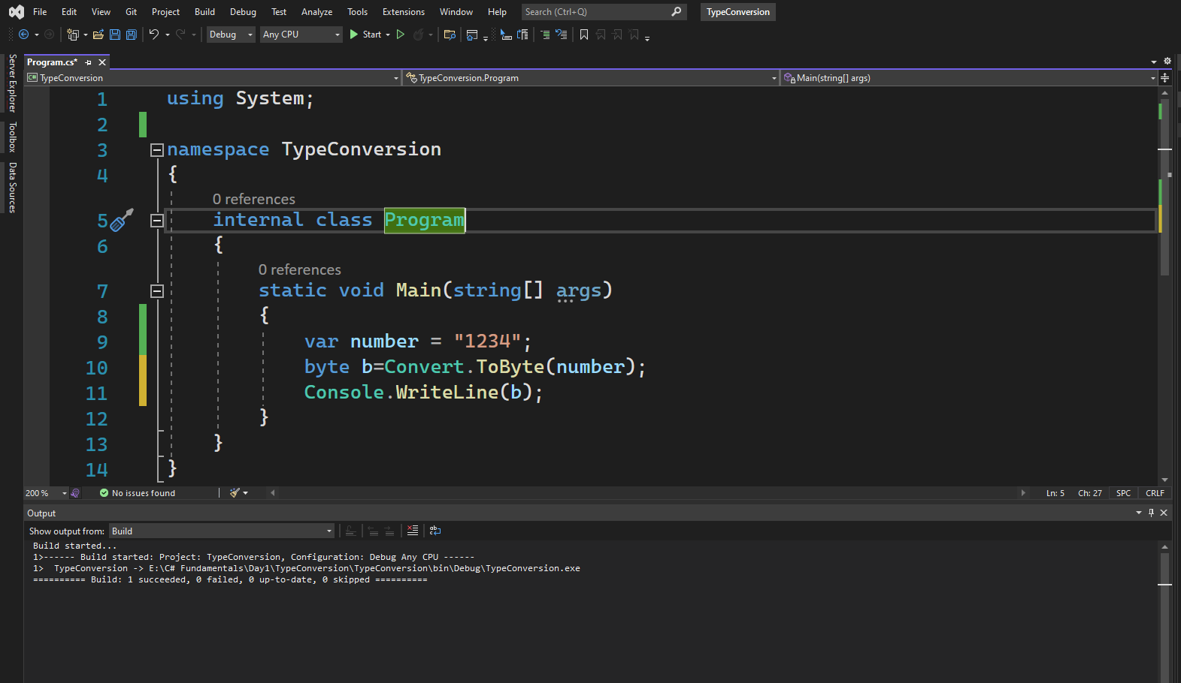

Slide 81
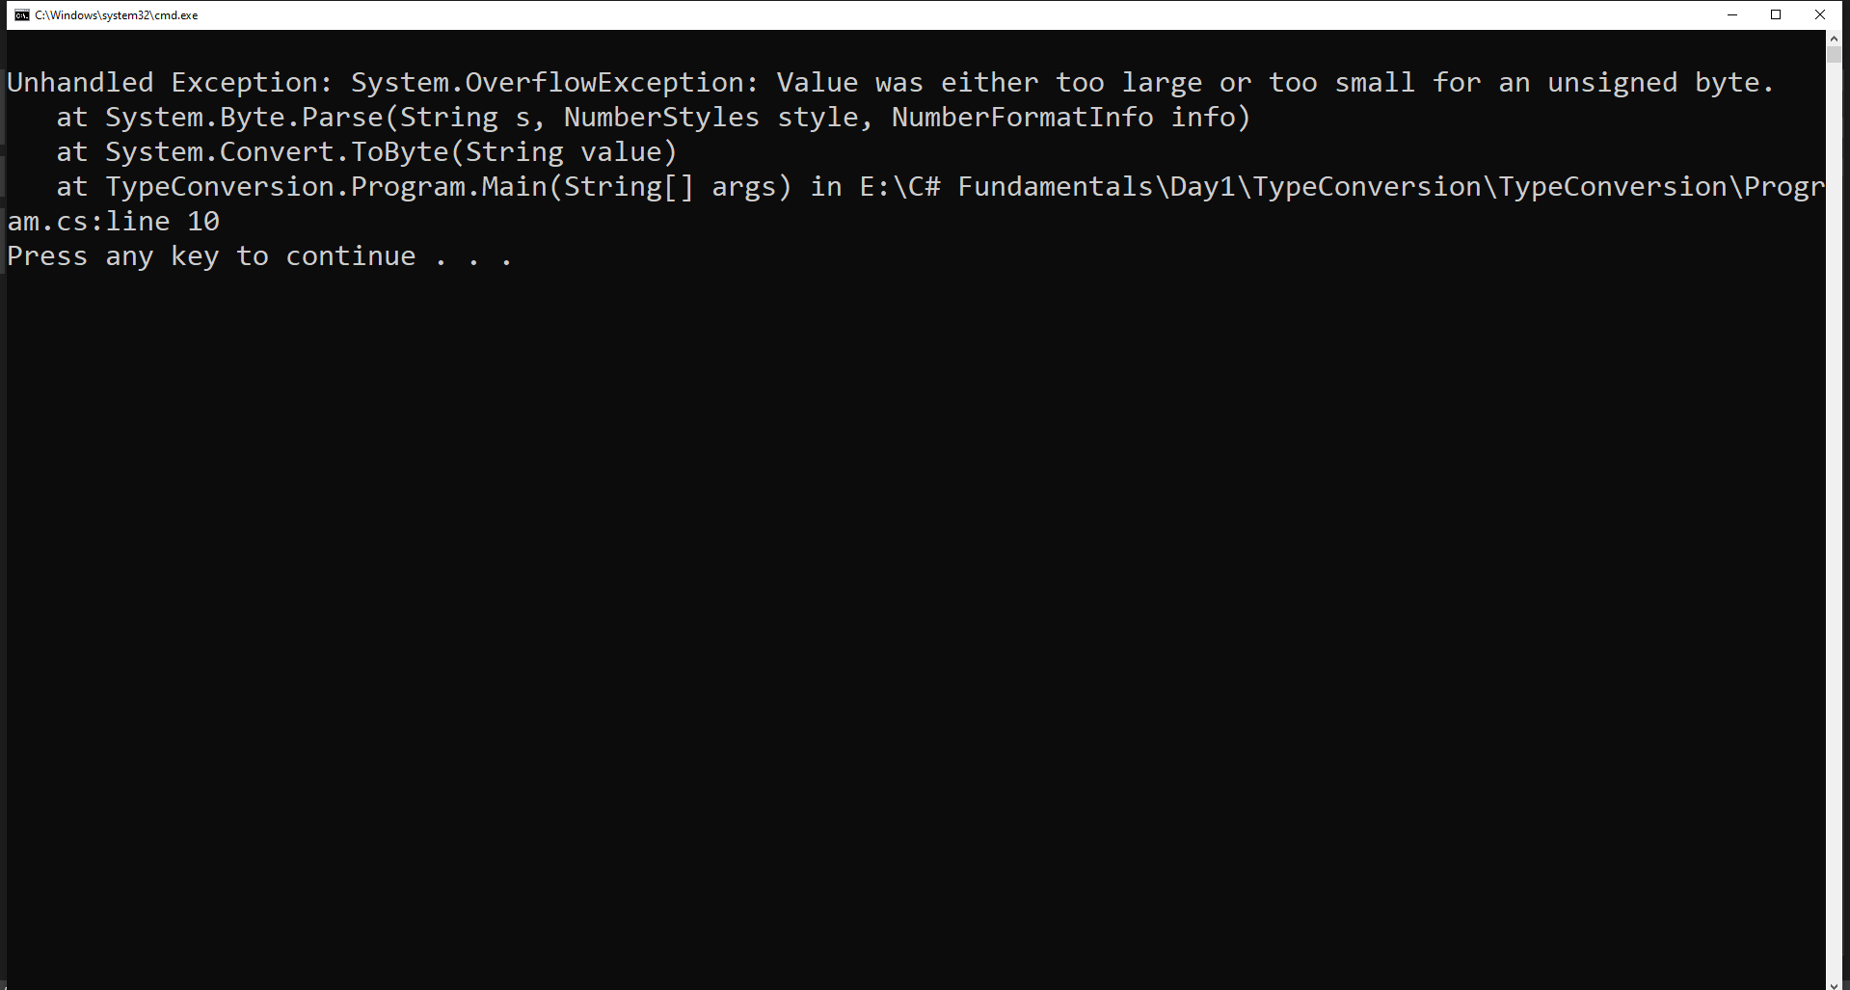


Slide 82


Slide 83


Slide 84


Slide 85


